Slide 1
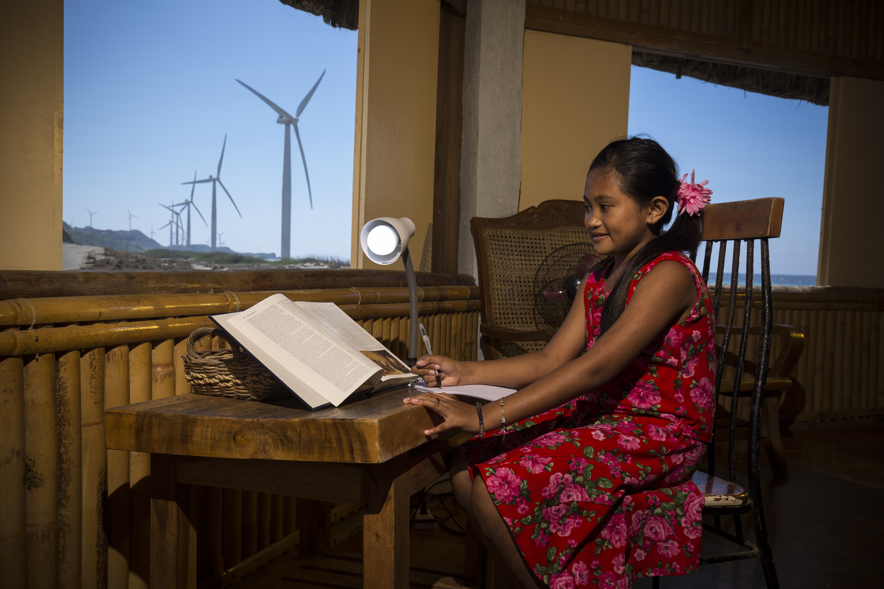
EU Green financing instruments
European Commission
Directorate General for International Cooperation and Development

Slide 2
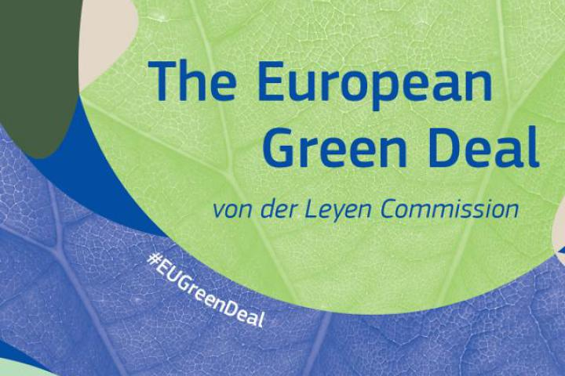
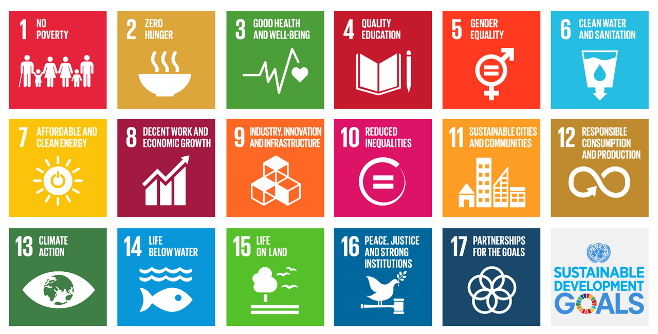
Context
770M people without access to electricity in 2019
$35 billion need to be spent annually from 2021 to 2030 on generation and electricity networks
Far from achieving SDG7…
Current NDCs insufficient to meet goals of Paris Agreement on climate change
Energy sector accounts for about 2/3 of global man-made greenhouse gas emissions
Need for global green energy transition to decarbonise the energy sector

Slide 3
NDICI
(2021-2027)
Context
EFSD
(-> 2020)
Blended finance
EFSD+
Geographical scope: worldwide
Geographical scope: the EU neighbourhood and Africa
Implemented with DFis
Implemented with DFis
Blended finance
For public and private investment operations and countries experiencing a balance of payment crisis
For public and private investment operations
EFSD Guarantees
External Action Guarantee

Slide 4
Innovative Financing Instruments

Slide 5
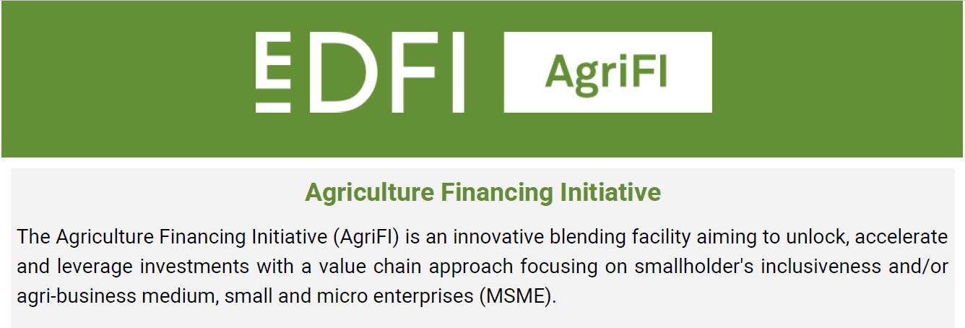
Innovative Financing Instruments

Slide 6
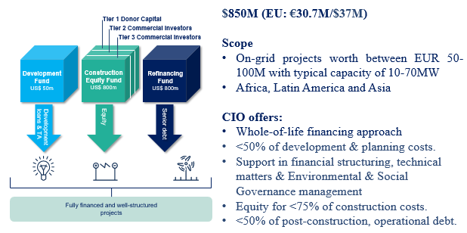
Innovative Financing Instruments

Slide 7
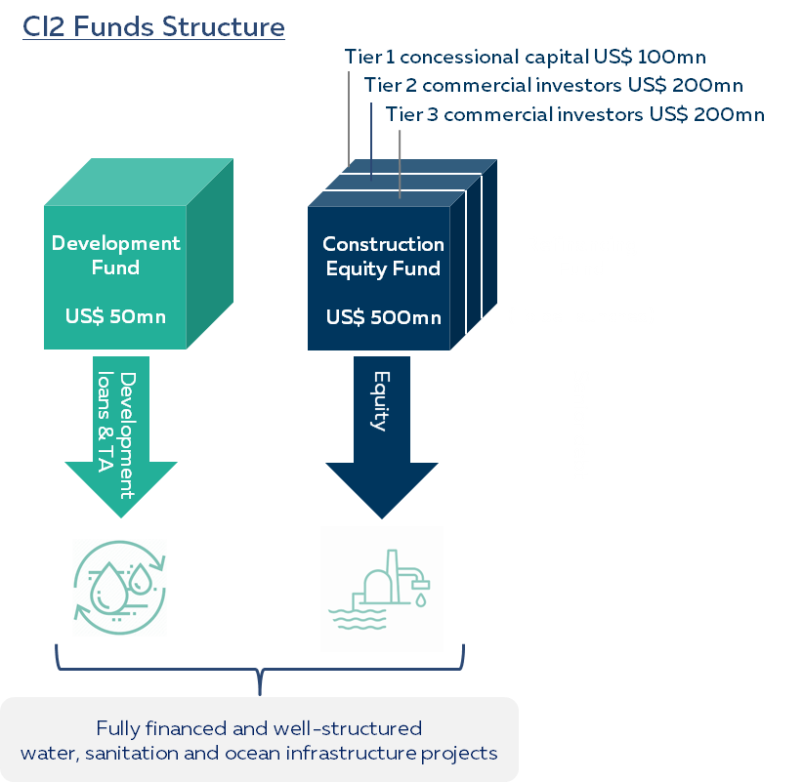
Innovative Financing Instruments
USD 550mln (EU: EUR 19.7mln)
Scope:
Global
CEF ticket size between USD 25mln and USD 75mln
Municipal & industrial water and wastewater supply, desalination, bulk water supply, waste and wastewater to energy, riverine and coastal ecosystem management and protection

Slide 8
For more information
ElectriFI: https://www.electrifi.eu/
AgriFI: https://www.agrifi.eu/
Climate Investor One: https://climatefundmanagers.com/funds/#CIO
Climate investor 2: https://climatefundmanagers.com/funds/#ci2
Thank you !

