Slide 1
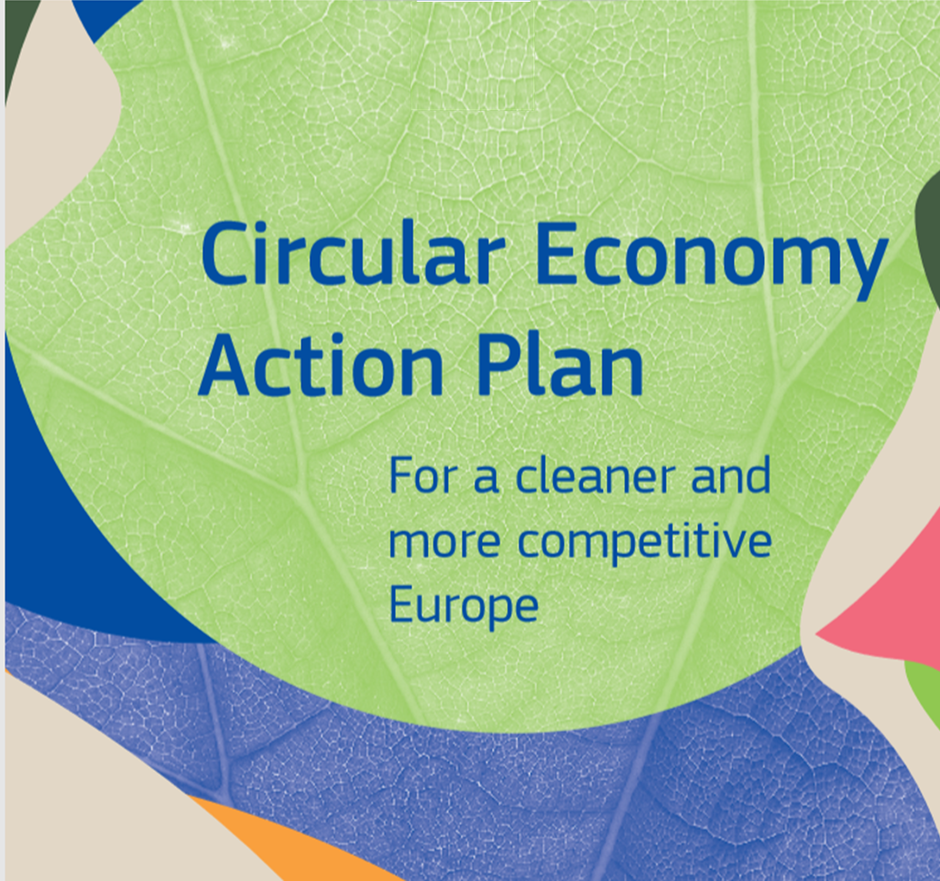
Astrid Schomaker
Director
DG Environment
European Commission
Notes:
Key messages:
The European Green Deal is a set of policy initiatives by the European Commission with the overarching aim of making Europe climate neutral in 2050. A Communication on the European Green Deal was adopted on 11 December 2019. The EGD is the European Union’s roadmap for making the EU's economy sustainable. This will happen by turning climate and environmental challenges into opportunities across all policy areas and making the transition just and inclusive for all.
CEAP is a key component of the European Green Deal.
It’s main principles can be taken on board by any economy. For a country like Uzbekistan, which is rapidly developing and is incresing consumption and production, moving to circular economy is a necessary step to provide for resource efficiency, and for competitive economy.
It is worth pointing out that water efficiency, one of components of circularity, is crucial for Uzbekistan. The country needs to substantially improve water efficiency, in particular with a view of warter scarcity due to climate change, and because Uzbekistan is a world leader in growing water-intensive cotton.
It is also worth mentioning that energy efficiency, another EGD important topic, needs to be improved as we can see still high energy intensity in many countries, including Uzbekistan.

Slide 2
CLIMATE
PACT AND CLIMATE
LAW
PROMOTING
CLEAN
ENERGY
INVESTING IN MORE
SUSTAINABLE,
SMARTER MOBILITY
PROTECTING NATURE
MOBILISING INDUSTRY
FOR A CLEAN AND
CIRCULAR ECONOMY
The European
Green Deal
FROM FARM
TO FORK
ELIMINATING
POLLUTION
LEADING THE
GREEN CHANGE
GLOBALLY
ENSURING
A JUST TRANSITION
FOR ALL
MAKING
HOMES ENERGY EFFICIENT
FINANCING
GREEN
PROJECTS
Notes:
Building blocks of the European Green Deal
CE is at the heart of the new regenerative growth strategy for Europe triggered by the Green Deal;
Therefore, the circular economy is supported via the Green Deal in two ways: 1) with the new CEAP; 2) by mainstreaming circularity across all others initiatives of the EGD
To achieve climate neutrality, the EU needs to reduce its material footprint and increase significantly its circular material use rate;
Thanks to CE, it will be possible to achieve the Green Deal targets by scaling up the circular economy from front-runners to the mainstream economic players;
CE provides a future-oriented agenda for achieving a cleaner and more competitive Europe in line with the transformational change promoted by the Green Deal;
CE addresses the conditions to achieve a circular economy where natural systems are protected and regenerated, harnessing the contribution of the circular economy to climate neutrality and the achievement of the 2030 Sustainable Development Goals.

Slide 3
Changing the way Europe consumes and produces
Make sustainable products the norm in the EU
Empower consumers and public buyers
Sustainable production processes
Making circular economy work for people, regions and cities
Sustainable Product Policy Framework
Circular economy as a requisite for climate neutrality
Electronics and ICT
Batteries and vehicles
Packaging
Plastics
Textiles
Construction and buildings
Food, water and nutrients
Getting the Economics Right
Financial Markets
Key Value Chains
Less Waste More Value
Investments and R&I
Global Level Playing Field
Reduce Waste
Reduce Waste Exports
Boost market for high quality and safe secondary raw materials
Monitoring
35 actions
Notes:
Key message: comprehensive action plan along the entire life cycle of products.
3 focus areas: products, key value chains, less waste more value

Slide 5
Less waste, more value
Prevent waste in the first place
Specific waste reduction targets for more complex streams
Enhance the implementation of the requirements for EPR schemes
Continue modernising EU waste laws (packaging, end-of-life vehicles, hazardous substances in electronic equipment; batteries adopted Q4 2020)
Propose to harmonise separate waste collection systems
Transform waste into high-quality and safe resources in markets for recycled materials
Develop chemicals that are sustainable and safe by design
Reduce the presence of hazardous substances detrimental to health and the environment
Assess the scope to develop further EU-wide end-of-waste criteria for certain waste streams
Address waste exports
Establish ‘recycled in the EU' as a benchmark for quality secondary materials
Thoroughly review EU rules on waste shipments, increasing the processing of materials
Adopt multilateral, regional and bilateral measures to combat environmental crime
Notes:
Out of key components of EGD, like eco-design or empowering consumers, an extremely important part and perhaps also the most relevant for Uzbekistan is addressing waste management. This is done in the EU following the waste hierarchy, in which waste prevention is the most desirable action.

Slide 6
Towards a global circular economy
An agenda to promote CE at bilateral, regional and multilateral level, including through development & international cooperation programmes
Kick-start negotiations for a Global agreement on plastics
Global Circular Economy and Resource Efficiency Alliance
CE in free trade agreements
Outreach activities – i.a. Circular Economy Missions
Initiate discussions for a global agreement on natural resource management
‘Safe operating space’ for natural resource use
Q1 2021 (UNEA 5)
Ongoing
‘Leading the way to a global circular economy: state of play and outlook’
Notes:
On international front, in the coming period:
1. We will lead efforts to reach a global agreement on plastics, and promote the uptake of the EU’s circular economy approach on plastics;
2. We have launched a Global Circular Economy Alliance to identify knowledge and governance gaps and take forward partnership initiatives;
The Commission is already working to:
Ensure that Free Trade Agreements reflect the enhanced objectives of the circular economy;
Outreach activities are stepped-up, including through the European Green Deal diplomacy and – when the covid emergency will make it logistically possible- the Circular Economy missions. The EU will work with EU Member States to enhance coordination and joint efforts for a global circular economy.
Safe operating space & discussions on global agreement on natural resource use management are scheduled for post-2021.

Slide 7
Mainstreaming circularity
Biodiversity Strategy for 2030 to protect our fragile
natural resources
Farm to Fork Strategy to make food systems more sustainable
Renovation Wave to boost renovation in line with circular principles
Chemical Strategy for Sustainability to ensure chemicals are safe and sustainable
Adopted:
Circular Economy in the context of the European Green Deal
Notes:
However, we cannot see CE and the Circular Economy Action Plan in isolation; in fact, the circular economy remains a priority in the latest deliverables of the European Green Deal:
The Biodiversity Strategy for 2030 acknowledge the role circularity can play to help reduce the economic system’s negative effect on biodiversity
The Farm to Fork Strategy combats food waste and integrate circularity thinking in the food system
The recently adopted Renovation Wave integrates circular economy principles, to make the renovation of buildings in Europe circular and sustainable on top of energy efficient – for example by supporting the use of Level(s) and life cycle thinking when carrying out renovation efforts.
The Chemical Strategy for Sustainability proposes a series of actions to ensure that products are safe and sustainable-by-design, and downstream, to increase safety of and trust in recycled materials and products, making ‘Recycled in the EU” a benchmark worldwide.

Slide 8
Thank you Learn more here: https://ec.europa.eu/environment/circular-economy/index_en.htm
© European Union 2020
Unless otherwise noted the reuse of this presentation is authorised under the CC BY 4.0 license. For any use or reproduction of elements that are not owned by the EU, permission may need to be sought directly from the respective right holders.
Notes:
The COVID-19 crisis has reinforced our resolve towards a green transition. While containing the virus and saving lives are the focus of our immediate efforts, climate change, terrestrial and marine biodiversity loss, excessive use of resources and pollution on land and at sea are also existential and global emergencies. They are as relevant as ever.
The COVID19 recovery is also the chance for Governments to show that they are capable of addressing these challenges by building more inclusive and more resilient societies for the health and well-being of their citizens. Economic recovery from the COVID-19 crisis should not compromise on environmental targets.
EU is putting the European Green Deal at the heart of our recovery efforts. To build resilience, create growth and jobs, we need investments in key green sectors. These include “smart circular economy”, the “renovation wave”, clean transport, sustainable food, clean energy, tackling pollution, and protecting and restoring biodiversity and natural ecosystems

