Slide 1



SME DEVELOPMENT AND GREEN FINANCING IN UZBEKISTAN
Isomiddin Akramov
Project Manager, ACTED Uzbekistan

Slide 2

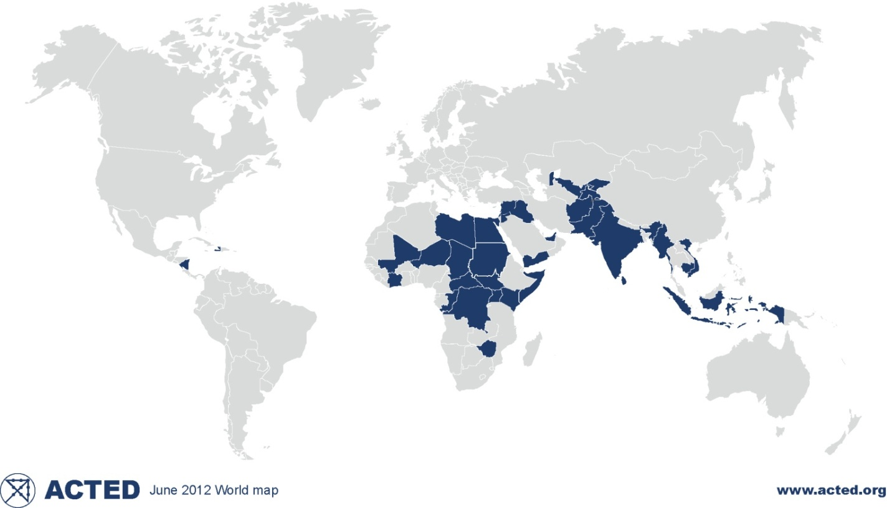
Background information about ACTED
An NGO founded in 1993 and based in Paris. Independent, private and Non-Governmental Organization, ACTED respects a strict political and religious impartiality and operates according to principles of non-discrimination and transparency
ACTED supports vulnerable populations affected by wars, natural disasters or economic and social crises, and accompanies them in building a better future, by…
Implementing 300 projects per year in 35 countries across the world
Adapting a context specific, multidisciplinary approach which is both global and local

Slide 3
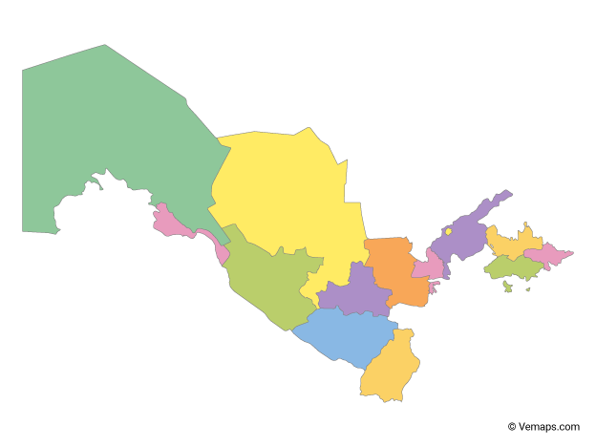
SME Development in Uzbekistan
SME distribution by sector (2020)
411,2 thousand SMEs operating in Uzbekistan
Karakalpakstan 18,288
Syrdarya
13,360
Tashkent 85,687
Fergana 36,117
Source: State Statistics Committee of the Republic of Uzbekistan (2020)

Slide 4


SME Development in Uzbekistan
Importance of SMEs in the economy
UZB ranked 69th among 190 countries in the Doing Business
SME share in GDP of UZB 54% (2020)
SMEs provide 78% of jobs or 9938 thousand people
GDP MAKING
EMPLOYMENT
DOMESTIC OUTPUT
(industry)
EXPORT
Source: State Statistics Committee of the Republic of Uzbekistan

Slide 5
Challenges with green financing in Uzbekistan
01
Lack of
awareness
02
Lack of capacity and skills
Lack of access to green finance
03
04
Lack of financial education and literacy
Lack of
promotional incentives
05

Slide 6
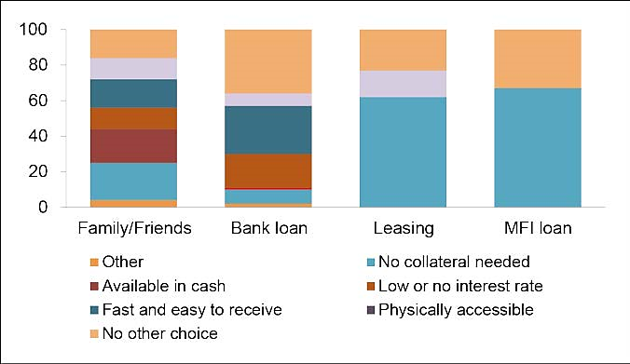
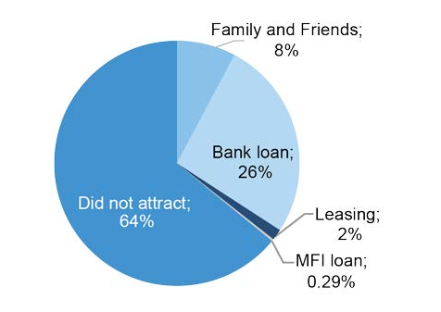
Barriers to SME finance
High cost of bank credit
Delivery Mechanism
Collateral requirements
Lack of alternative sources of SME financing
21% - choosing family and friends (no collateral)
37% - they had no other choice than to go to the banks
67 % - used MFIs services because they are fast and easy
SME Sources of Finance
Source: 2018 IFC Demand study Micro and Small Business Finance & Digital Financial services in Uzbekistan
Notes:
There is a limited choice for SMEs in terms of variety of sources of finance. Sources of SMEs’ finance in Uzbekistan are classified as informal and formal. Informal sources of financing include personal savings, friends, relatives, business partners and unregistered moneylenders. Primary sources of finance are self-financing, such as the profit of the enterprise, reserve financing and capital increase by the founders’ contributions.
Evidence from enterprise-level surveys suggests there is more room for growth to extend financial services to smaller enterprises. According to a World Bank/International Finance Corporation Survey conducted in Uzbekistan in 2018,13 64% of surveyed firms in Uzbekistan reported using bank financing and 8% – having family and friends’ support. Nevertheless, a large proportion of Uzbek SMEs finance their growth internally – 64% report self-financing. See Figure 6.
Among micro and small businesses there are low levels of financial leveraging: Almost two thirds of businesses do not attract financing. Banks constitute almost exclusively the only formal source of financing in Uzbekistan. The majority of respondents who participated in the in-depth interview claimed that they would register their informal business in order to take a bank loan, which provides the opportunity to develop this segment.
Twenty-one percent of the respondents stated that the biggest reason for choosing family and friends was that no collateral was needed and the money was available in cash (19% of total respondents), 37% of the respondents noted, that they had no other choice than to go to the banks. Respondents noted that only banks can provide the requested amounts. Sixty-seven percent of the respondents used microfinance institutions (MFIs) services because they are fast and easy to deal with, and 33% of the respondents noted there is no choice except an MFI loan. For trade and services, the most important item that was quoted was availability in cash. For agriculture producers, no collateral required and low interest rates are the most important (government-supported programs available).

Slide 7







Green financing opportunities in Uzbekistan
Bank | Source of origin | Interest rate (annual) | Benefits
 | EBRD, GEFF | 21% | Opportunity to receive grants – 10% for EE and 20%% for RE upon successful implementation
 | FMO Entrepreneurial development bank | 24% | N/A
 | IFC | 20% | Assistance by IFC to support MSMEs during pandemic
 | WB | N/A | Under Energy Efficiency Facility for Industrial Enterprises Project
 | WB | N/A | Under Energy Efficiency Facility for Industrial Enterprises Project

Slide 8
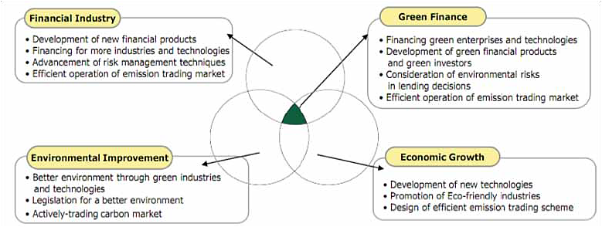
The green finance interface
Source: Jin Noh Hee, Financial Strategy to Accelerate Innovation for Green Growth (2010).
Notes:
Green finance is a core part of low carbon green growth because it connects the financial industry, environmental
improvement and economic growth (figure 1): “One missing link between ‘knowing’ and ‘doing’ in the
transition to green industry is ‘green finance’. All green industrial propositions cost money, and many green industry
business models are more often than not untested or unconventional. Therefore, traditional finance may find
it difficult or commercially unattractive to finance these green industrial propositions.”

Slide 9
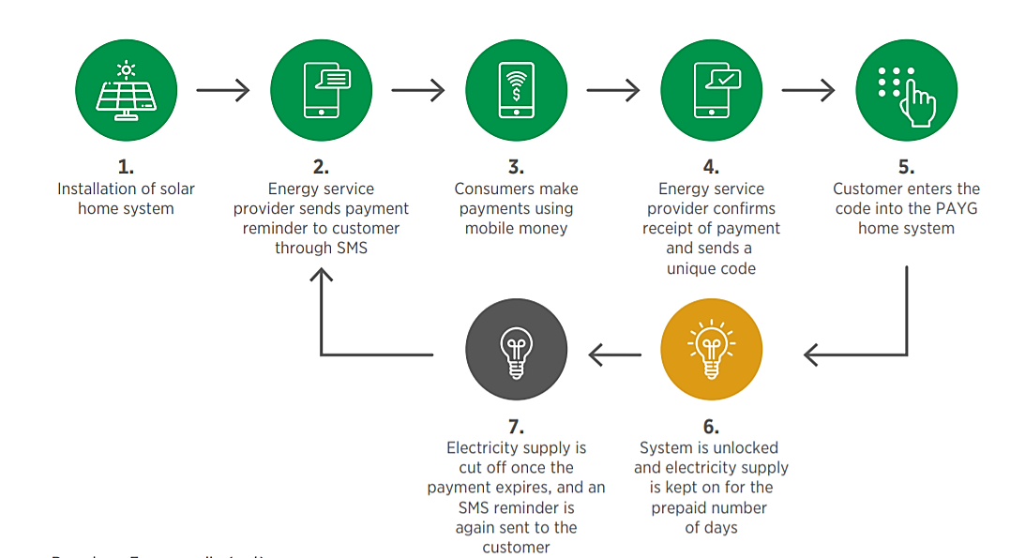



Alternative solution: PAYGO model
What is Pay-as-you-go (PAYGO) model?
It is a financing technology that allows end-users to pay for solar energy in weekly instalments or whenever they are financially liquid.
What are the benefits?
affordable energy access from renewable sources to off -grid communities
does not require to purchase significant capital prior to its use
https://adjpower.com

Slide 10

Background information about ACTED
ACTED aims to green the organisation by reducing our carbon footprint and upscaling our work on climate change and environmental protection to account for a minimum of 25% of our programming by 2022.
24 COUNTRIES - implementing projects with environmental components
The EU funded Sustainable Energy for Tourism project
strives to improve the competitiveness of SMEs and support long-term
reduction of the carbon footprint in the tourism sector
through innovative, inclusive and sustainable approaches
like promoting SCP practices
Eco certification
Green Hostels
Match making platform for SMEs
Catalogue of RE/EE products
6 Green Finance products

Slide 11



Thank You!
IN 2021
Contact us
Isomiddin Akramov,
Project Manager - tashkent.switch2pm@acted.org
www.acted.org
2021

