Slide 1









Measures to promote sustainable energy and implications for COVID-19 green recovery in Uzbekistan”
Scott Foster
Director
UNECE Sustainable Energy Division
ENERGY

Slide 2

Envelope
Materials Design
Construction
Systems
HVAC
Plug-ins
Building Back Better with High Performance Buildings
Services
Food
Water
Waste
Energy
On-site
Off-site
High Performance Buildings
Deliver Quality of Life:
Comfort, Health, Affordability, Efficiency, Sustainability
ICT
Smart Connect
& Monitor
Mobility
City design
Low-C mobility

Slide 3

Resources for Sustainable Development
Rewriting the resource management narrative
Hydro Energy
Solar Energy
Wind Energy
Bioenergy
Geothermal Energy
Anthropogenic Resources
Injection Projects
Uranium
Oil & Gas
Minerals
Coal
UN Resource Management System (UNRMS) focuses on progression of resource projects, social acceptability and investment readiness
Notes:
Sustainable Resource Management is crucial for achieving the 2030 Agenda.
But countries and companies have challenges to manage natural resources sustainably
Minerals and petroleum are often seen as “drain industries” that “extract” wealth and leave behind social and environmental problems.
UNECE has developed the United Nations Framework Classification for Resources (UNFC) which is globally applicable for all energy and mineral resources and also now secondary (manmade) resources.
Countries are now asking that UNFC be transformed into a tool for governments and industry to manage
resources more sustainably. The United Nations Resource Management System (UNRMS) is now under development.
UNRMS will align with the SDGs, ensure financial resilience through business process innovation and
derive good social, environmental and economic outcomes.

Slide 4
Getting Renewables Right
Decarbonization; Green Jobs; Energy Access

Slide 5
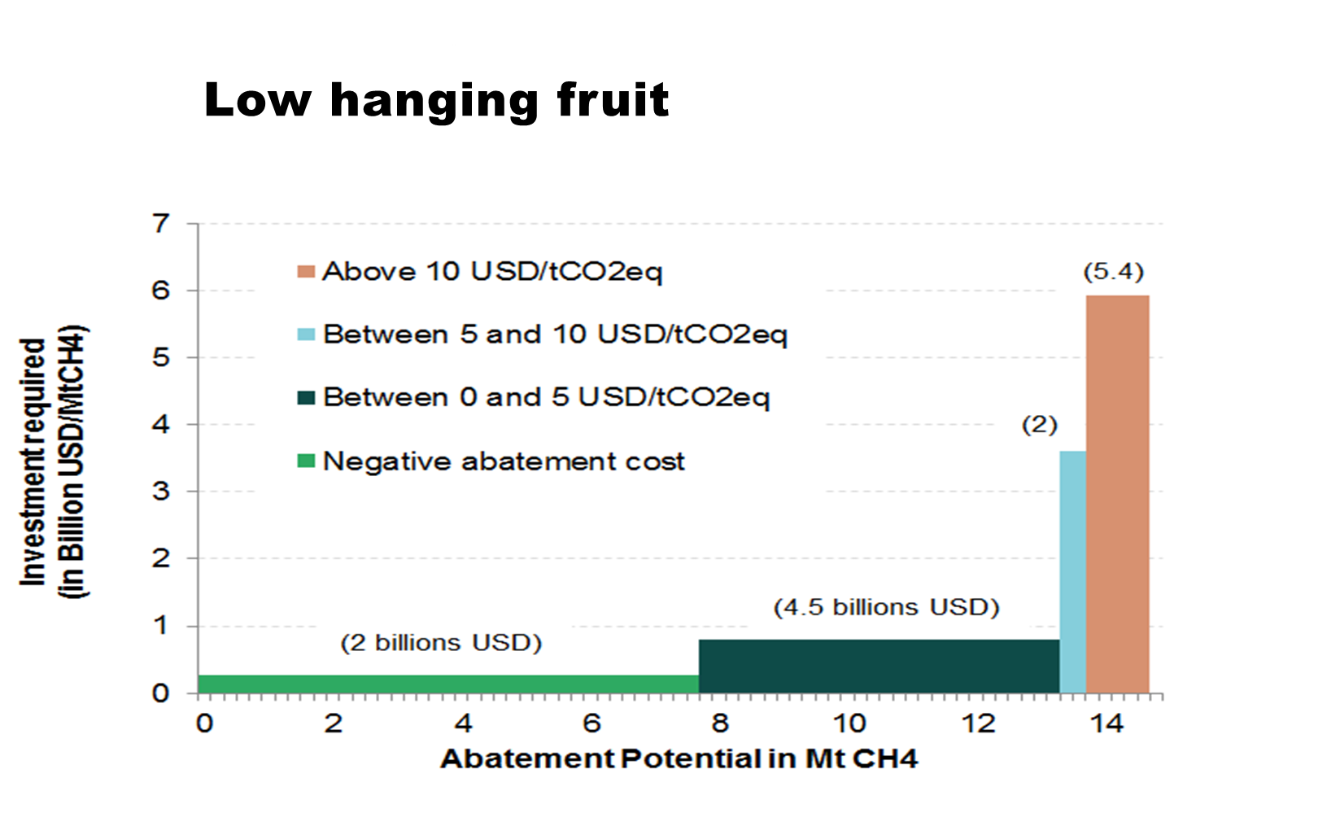
Methane Management

Slide 6
ENERGY
Thank you!
Scott FOSTER
Director
UNECE Sustainable Energy Division
+41 22 917 2444
scott.foster@un.org

