Slide 1
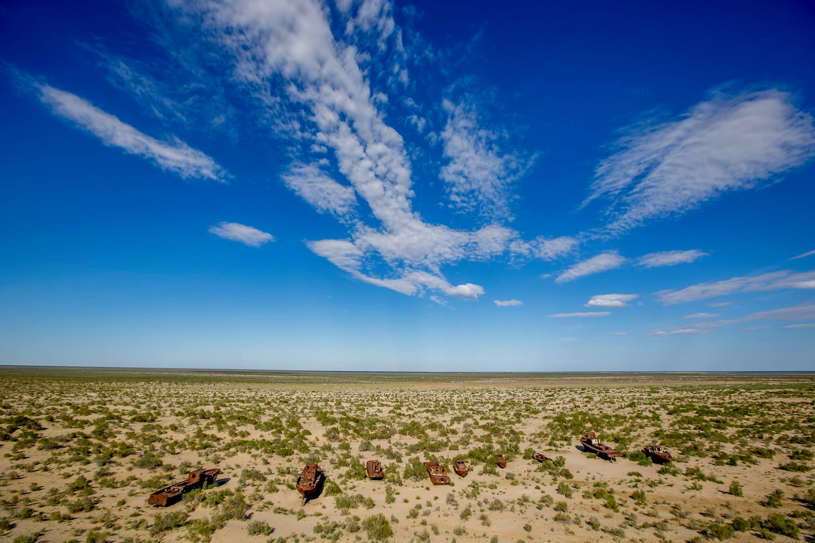
Regional Economic Development Cooperation and National Economies:
A Call for Green Recovery
Building Forward Better: A COVID-19 Green Recovery for Uzbekistan
Tashkent, 3-4 March 2021
George Bouma – Regional Team Leader, Inclusive Growth UNDP

Slide 2
Regional Opportunities and Challenges
Opportunities | Challenges
Stronger market, governance reform agendas—especially in Uzbekistan | Lagging reforms and impact of COVID-19
Increased interest in intra-regional and cross-regional cooperation (e.g. Aral Sea, Ferghana Valley) | Institutions need strengthening and human resources capacities (public, private)
Progress in extra-regional integration (e.g., WTO, BRI) | Undiversified economies, many people “left behind”
Agenda 2030/SDGs (growing focus on sustainable development, integrated policy, programming approaches) | Unsustainable natural resource use
 | Climate/disaster risk management
Regional market and common policy frameworks promoting new technology and investments (eg CAREC energy policy) | Political economy risks Access to resources

Slide 3
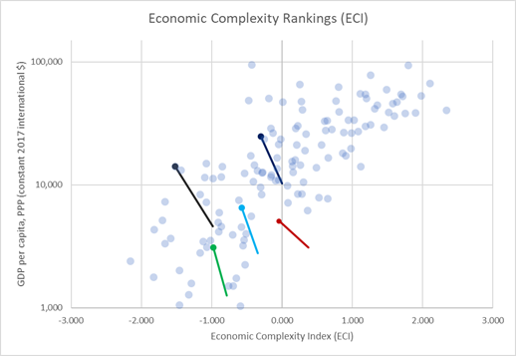
Macro-economic Resilience
Economies of Central Asia are becoming less diverse - more urban and service oriented
Increasing vulnerability to shocks – commodity/natural resources dependent
Currency volatility and inflationary pressure
Value chain disruptions - future value chains and the digital agenda
COVID-19
and Central Asia:
Socio-economic
impacts and key policy
considerations for
recovery*
Economic complexity and GDP per capita 2000-2017

Slide 4
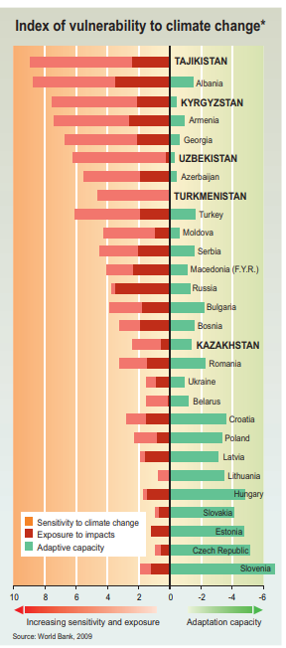
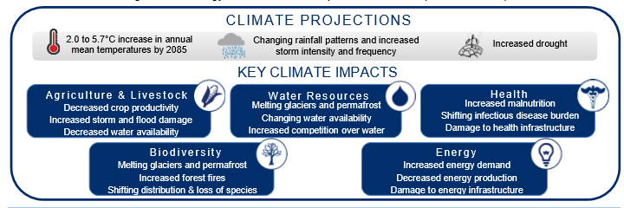
Climate Change Trends and Key Sectors
Source: USAID, Climate Risk in Central Asia: Region Risk Profile
Notes:
Water-agriculture-energy nexus
• Water for Food: Irrigation, livestock, food processing
• Water for Energy: Heating, cooling thermal power plants, hydropower, irrigation of bioenergy crops, extraction and refining
• Energy for Water: Extraction and transportation, water treatment, desalinization, wastewater, drainage, treatment and disposal
• Energy for Food: Crop and livestock production, processing and transport, food consumption, energy for irrigated crops
• Food for Energy: Competition between bioenergy and food and fibre, production for water and land
• Food for Water: Impact on water supply, impact of run-of

Slide 7
Building Resilience in Recovery
Health governance and information remain critical
Financing and policy choices for the green economy eg FFS
Labor markets and transition to formality and skills and gender gaps
Social safety nets and coverage for all in transition from welfare to employment
Technology and digitalization – trade and green technology
Regional cooperation can enhance these policy areas
COVID-19
and Central Asia:
Socio-economic
impacts and key policy
considerations for
recovery*

