Slide 1
TNS Medium Gallup Attitudes towards the Impact of the Refugee and Migrant Crisis in Serbia’s Municipalities 2016

Slide 2
Introduction
As part of the project entitled Strengthening Coordination and Municipal Response to the Migrant Crisis,
TNS Medium Gallup, in cooperation with the United Nations Development Programme (UNDP), conducted a survey of attitudes towards the impact of the migrant crisis on the municipalities in Serbia.
Survey objective | The objective of the survey was to identify the needs of local self-governments and communities most heavily exposed to the impact of the migrant crisis.
Period | Two waves: March and September 2016
Territory | 20 municipalities in Serbia, affected by migrant crisis, selected in agreement with UNDP Serbia
Sample | Target groups: General population Sample size: N~800 resp. per wave Sample type: 18+, stratified random sampling Method: face to face, in house of respondents 2. Local self-governments’ representatives Sample size: N~170 resp. per wave Sample type: targeted sample Method: combination of face to face, telephone and web interview

Slide 3
Analysis based on the impact of migrant crises on municipalities:
I grupa
II grupa
Šid
Preševo
I – Intensely affected
II – Moderately affected
Šid & Preševo
Municipalities more intensely affected by the crises:
Preševo
Šid
Kanjiža
Beograd (Palilula, Savski venac i Stari grad)
Bujanovac
Dimitrovgrad
Bosilegrad
Negotin
Municipalities moderately affected by the crises:
Zaječar
Pirot
Vranje
Surdulica
Vladičin Han
Smederevo
Aleksinac
Obrenovac
Sombor
In addition to the analysis by group, samples was also provided comprising around 60 respondents each, for Preševo and Šid, in order to carry out specific analyses at the level of individual municipalities because of the importance of these municipalities.

Slide 4
Citizens’ point of view

Slide 5
Socioeconomic issues most important for citizens
Most important issues
Living standard
CITIZENS: In your opinion, what ARE the most urgent PROBLEMS that is Municipality where you live faced? (in %)
CITIZENS: How would you describe living standard in which you and your family live right now? (in %)
4
=
1
1
4
2
1
2
Perception of migrants as problems in municipalities | Sep-16 | Sep 16- Mart 16
I – More intensely affected by the crises | 22 | + 6
Preševo | 6 | - 38
Šid | 16 | + 12
II – Moderately affected by the crises | 9 | - 6
6
2
=
=
Base | Total
 | 811
 | 800
1

Slide 6
Neutral opinion about the migrants prevails among citizens, with negative tendency
Lower level of information about the migrant crisis on the part of citizens is correlated with the citizens’ neutral and negative opinion about migrants.
CITIZENS: How well are you informed about migrant/refugee crisis overall? (in %)
CITIZENS: In general, what is your attitude towards migrants/refugees entering Serbia? (in %)
Base | Total
Sep-16 | 811
Mar-16 | 800

Slide 7
Citizens’ attitudes towards migrants in municipalities
Attitudes towards migrants/refugees
CITIZENS: In general, what is your attitude towards migrants/refugees entering Serbia?
Average score on the scale 1-5 (1 „very negative opinion“ - 5 „very positive opinion“)
Average – 2016 | 2,70
March 2016 | 2,66
September 2016 | 2,73
1
2
3
The lowest scores
(up to 2,5)
Lower scores (2,5-2,9)
Middle scores (over 3,0)
50 | 120 | 42 | 62 | 124 | 36* | 124 | 55 | 67 | 60 | 285 | 44 | 118 | 81 | 94 | 51 | 80 | 32* | 32* | 54
Base: 1611, March and September 2016 merged, by municipality *Very small bases (below 40 respondents)

Slide 8
Citizens understand the reasons for migrations
Although the majority of citizens believe that migrants are leaving their countries because of wars and lack of safety in these areas, socioeconomic reasons are more frequently mentioned in Autumn 2016.
CITIZENS: In your opinion, what is the key reason why migrants/refugees leave their original countries of residence? (in %)
CITIZENS: In your opinion, what is the final destination for migrants/refugees? (in %)
7
7
11
Base | Total
Sep-16 | 811
Mar-16 | 800

Slide 9
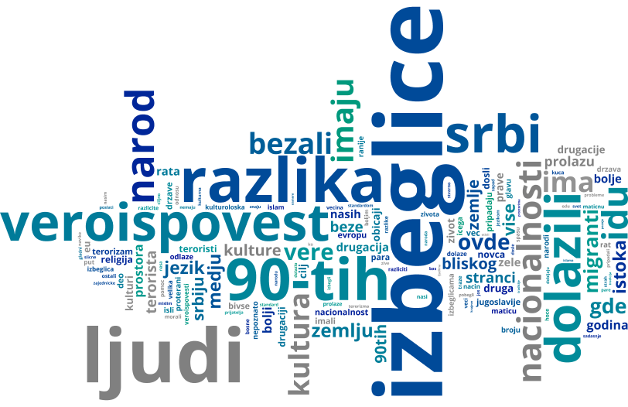
Citizens on the differences between the current migrants/refugees from the Middle East and refugees of the ‘90s in the former Yugoslavia
The level of identification of migrants/refugees from the Middle East with refugees of the '90s in the former Yugoslavia is partial. Prevailing perception of differences, having in mind different culture, religion and language.
CITIZENS: Which of the following is the closest to your opinion (in %):
There is no difference between current migrants/refugees from the Middle East and refugees of the ‘90s in the former Yugoslavia
There is a difference between current migrants/refugees from the Middle East and refugees of the ‘90s in the former Yugoslavia
Don’t know / No answer
Sep-16
Mar-16
Base | Total
Sep-16 | 811
Mar-16 | 800

Slide 10
Situation within municipality
3

Slide 11
Perception of migrant crisis in municipalities
Based on citizens’ perception from moderately affected municipalities, number of migrants is increasing, while the number stayed the same in municipalities intensely affected by the crises.
CITIZENS: Based on your perception in the last 6 months, has the number of migrants/refugees in your Municipality increased, decreased or stayed the same:
CITIZENS: Was your Municipality successful in dealing with the refugee/migrant crisis in your municipality/city?
Local self government stated satisfaction with municipalities’ efficiency when dealing with the crisis (over 90%).
Base | Total
Sep-16 | 811
Mar-16 | 800

Slide 12
What kind of help should migrants receive?
CITIZENS: In your opinion, what kind of help should migrants receive first? And then? (in %)
CITIZENS: Have you recently heard about any international financial support/donation to your Municipality aimed to help migrant/refugee crisis? (in %)
Sep-16
Mar-16
Citizens are willing to personally help migrants by providing food, clothing, information and necessary items for children. On the other hand, local self-government employees have indicated that the municipalities have made available to migrants the following services: accommodation, food, medical care, then clothing and transport, free communications (Internet access, mobile phone battery charging, use of phones), information, as well as humanitarian aid provided by the Red Cross.
Base | Total
Sep-16 | 811
Mar-16 | 800

Slide 13
Local self-government officials on migrant crises
LOCAL SELF-GOVERNMENT OFFICIALS: What are the other challenges/problems which employees of the local bodies face in delivering regular public services to population due to migrant/refugee crisis? (in %)
LOCAL SELF-GOVERNMENT OFFICIALS Which resources for your municipality’s functioning are most needed to ensure a continued successful response to the migrant/refugee crisis? (in %)
 | Mar-16 | Sep-16
Lack of technical resources /equipment | 29.0 | 34.0
Hygiene issues | 26.2 | 29.1
Lack of financial resources | 41.0 | 25.5
Lack of medical equipment and financing issues | 23.8 | 22.7
Lack of human resources | 23.7 | 22.0
DDD (disinfection and rodent/pest control) | 6.3 | 12.8
Bureaucratic obstacles | 8.4 | 11.3
Garbage collection | 20.4 | 8.5
Sewage system | 4.8 | 7.1
Water supply system | 7.0 | 5.7
Other | 5.3 | 3.5
Base | Total
Sep-16 | 167
Mar-16 | 176

Slide 14
Accepting migrants/refugees
4

Slide 15
Level of migrants’ acceptance
Low support of admitting migrants permanently, with majority opposing to opening centers for their accommodation in the territory of their municipality.
CITIZENS: Would you oppose or agree with the establishment of an accommodation facility of migrants/refugees on the municipal territory? (in %)
The closer the expected interaction is, the lower the level of willingness of citizens to participate in this interaction.
CITIZENS: In your opinion, should Serbia admit migrants/refugees permanently? (in %)
Citizens from Kanjiža, Zaječar and Šid most oppose to accepting migrants temporarily or permanently.
Biggest issue for admitting migrants/refugees permanently are poverty in Serbia, cultural, religious and language differences.
Base | Total
Sep-16 | 811
Mar-16 | 800
Sep-16
Mar-16

Slide 16
Clustering citizens attitudes towards migrants
Humane
Traditional
Show the greatest solidarity with migrants, have the most sympathy and think that the utmost should be done to help the migrants because they need assistance. Neutral and positive opinions about migrants significantly prevail in this group.
Moderate opinion, they believe that migrants should be accepted, but only those that will easily fit into society. Their attitudes are more conservative and they have more sympathy if migrants are of the same religion
High
SOLIDARITY
Frightened
Very much concerned about their personal safety due to the increased influx of migrants, and they are especially concerned about the safety of women. They have strong fears that there are potential terrorists among migrants. To a large extent, this group of people believes that migrants would not fit into society, and that people should not even be sorry for them because they have enough money for their needs.
Low
Moderate
High
CONCERNS

Slide 17
Municipalities’ dealing with migrant crisis
Concerns
Solidarity
Self-government
Migrants
How to deal with citizens’ concerns and fears?
How to motivate citizens’ solidarity?
What are priority needs of local self-governments and communities?
How to help migrants/refugees?
What is recommended for action in relation to the migrant crisis on local level?
Allocation of resources to crime prevention and the safety of citizens.
Improve level of citizens awareness through the media with a view to developing a higher degree of solidarity with migrants
Moving away from fears and prejudices, towards understanding of human stories of migrants / refugees.
Potential “leaders of change” towards positive opinion of migrants are “humane“, young people, and more educated citizens.
Motivating personal donations, organizing public activities (collecting food and clothes) in citizens’ neighborhood.
Donations promotion by representatives of local governments, organizing educations and public debates etc.
Maintaining and improving functioning of the municipalities receiving greater influxes of migrants (especially Kanjiža and Šid).
Allocation of financial, technical and human resources for municipal infrastructure (water supply, sewage, waste disposal and transport).
The provision of humanitarian aid to migrants (accommodation, food, clothing, medical care), with a special emphasis on vulnerable groups (women and children).
Allocation of resources to health care (human resources and equipment), ensuring higher level of hygiene.
7

Slide 18
Thank you!
TNS Medium Gallup | Savski trg 9, 11000 Belgrade | + 381 11 3613 230 | + 381 11 3613 230 | www.tnsmediumgallup.co.rs

