Slide 1
Support to Anti-Corruption Efforts in Kosovo (SAEK) Project
Presentation of the:
Public Pulse on Corruption
Oct-24-2016
Pristina, Kosovo

Slide 2
Methodology
Data collection for the public opinion poll was based on a survey of households: 1300 citizens
839 interviews with K-Albanians
233 interviews with K-Serbs
228 interviews with K-Other minorities
The total sample for interviews with public officials consisted of 500 interviews.
Four thematic focus groups for validation of data
276 central level
224 municipal level

Slide 3
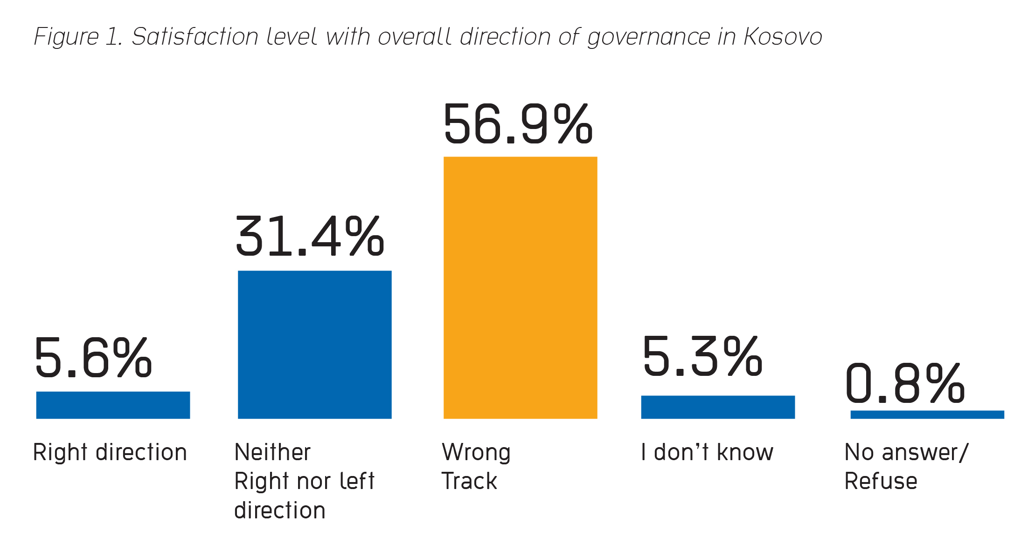
Main findings of the public opinion poll
Overall perception of the direction of governance in Kosovo
57% of Kosovars are of the opinion that Kosovo is going in the wrong direction,
6% believe that things are headed in the right direction,
31% believe that things in Kosovo are staying the same

Slide 4
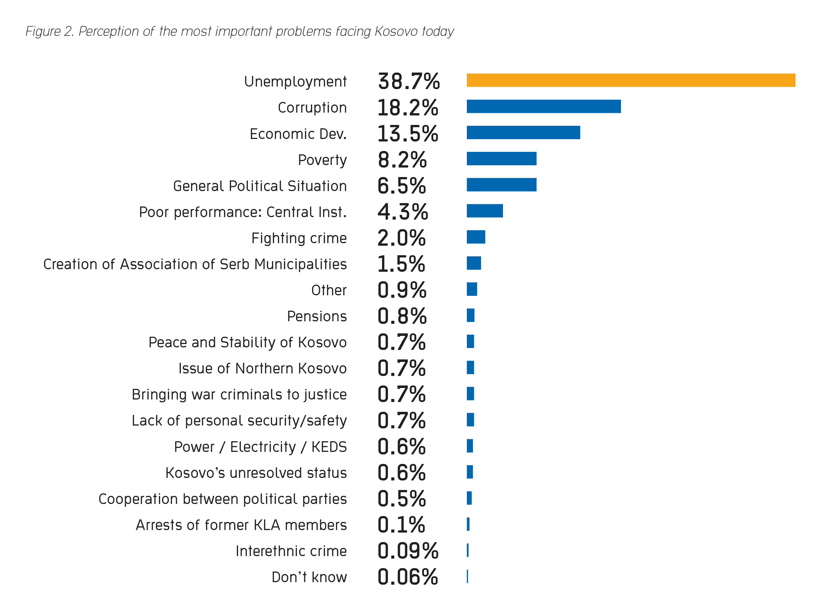

Slide 5
Perception about the level of
corruption
58% of respondents consider that the level of corruption in Kosovo has not changed over the last 12 months
31% believe that corruption has increased
12% that think it has decreased

Slide 6
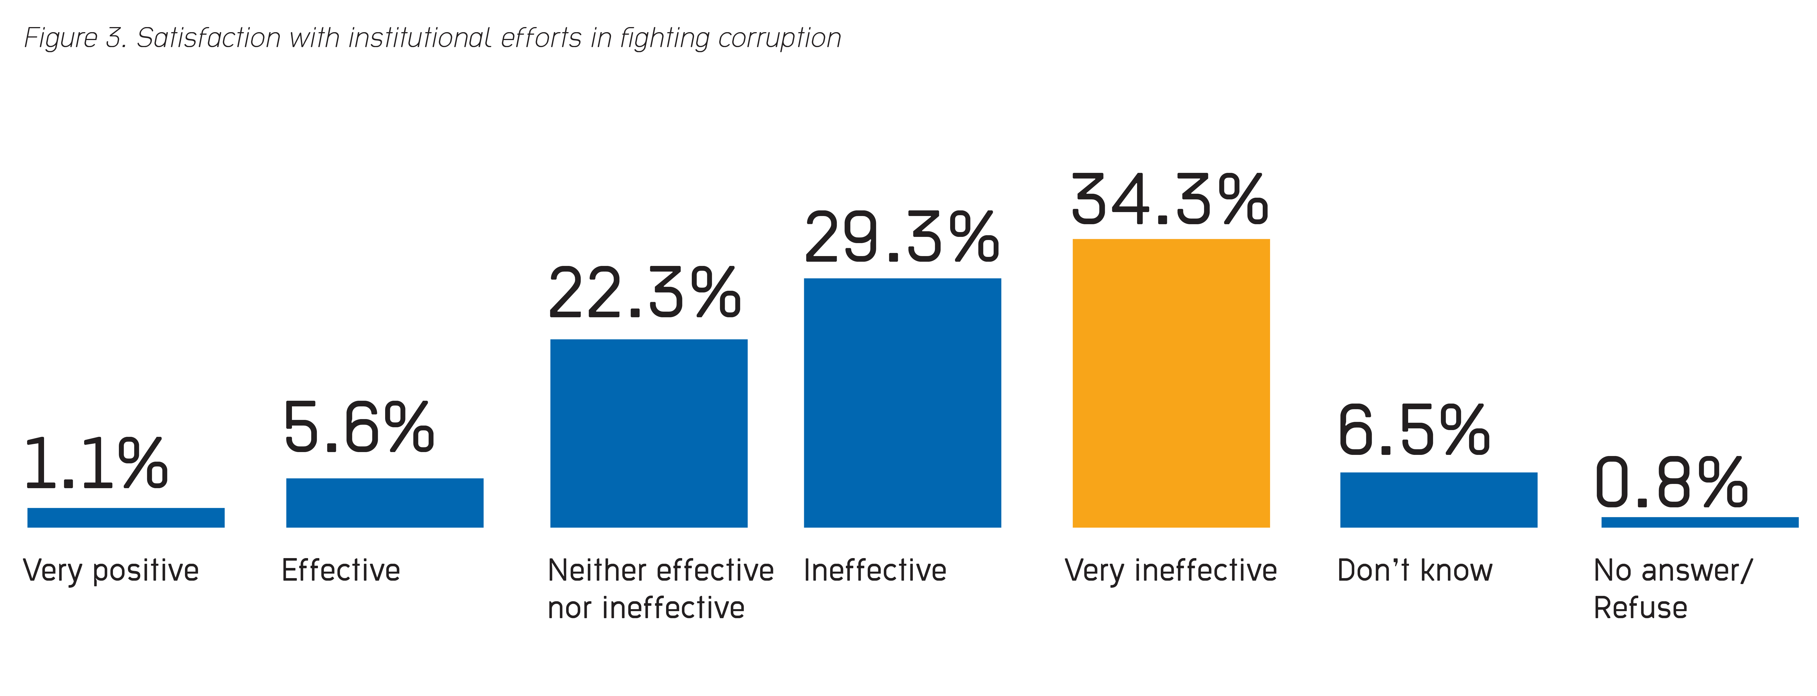
Effectiveness of anti–corruption efforts

Slide 7
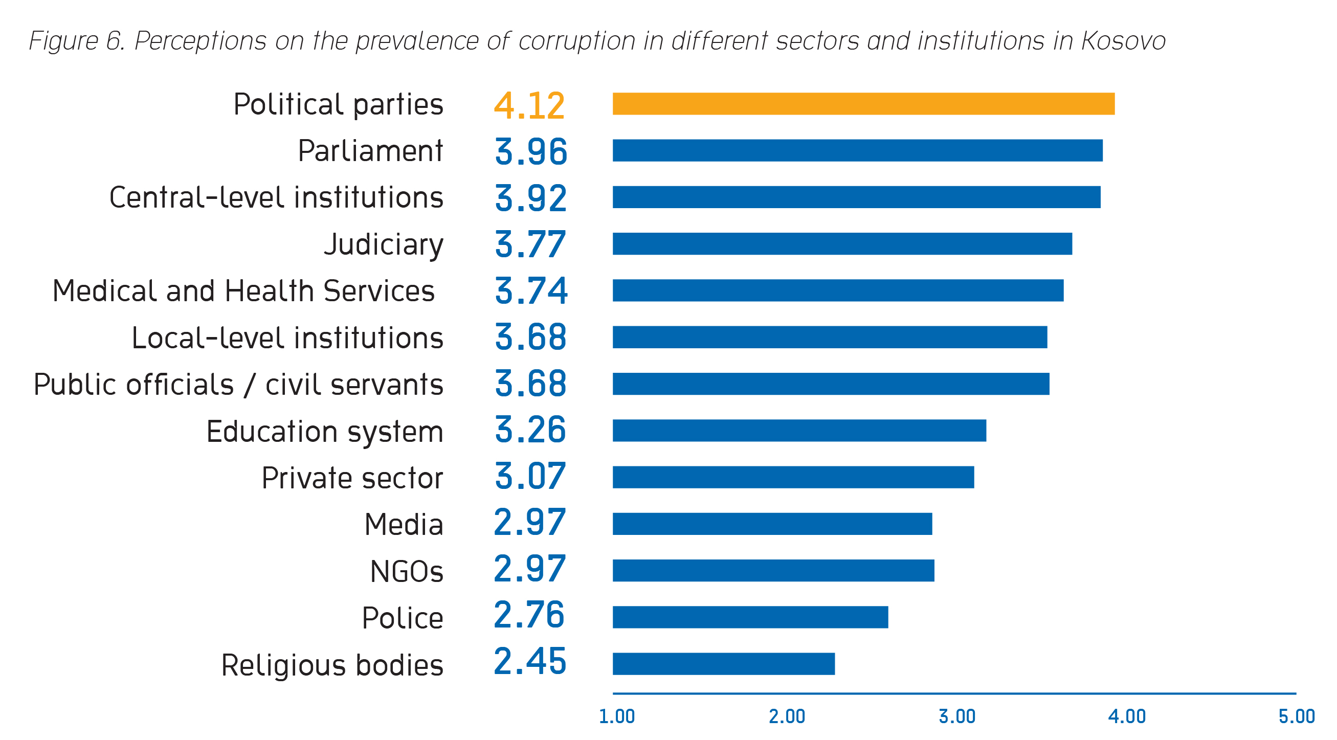

Slide 8
Perception vs actual corruption in law enforcement
Judiciary - a high percentage of perceived corruption is not followed with actual cases of corruption
Kosovo Police continues to be one of the most trusted institutions by the public when it comes to perception and actual reporting of corruption

Slide 9
Reporting on corruption
Only 9% out of 131 respondents who claimed to have witnessed corruption, actually reported it, which is only 1 % of the overall number of respondents
44 % reported corruption to police
31% reported it to the municipality
13 % reported it to the Anti-Corruption Agency
13 % reported it to the media
Non reporting: 55% of respondents said since it wouldn’t make any difference and 19% because they were afraid of the consequences

Slide 10
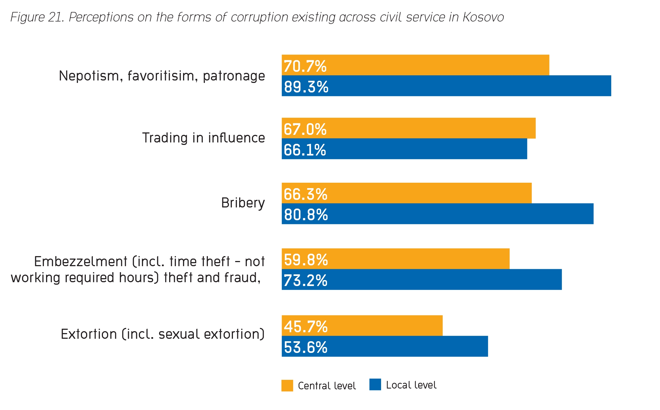
Public sector and corruption

Slide 11
Prevalence of corruption: Public sector

Slide 13
Reporting on corruption

Slide 15
Focus group discussion: Civil society
Responses have been influenced by the events such as the mass migration, decrease in employment, political crisis between the position and opposition, inefficiency of courts, etc;
In terms of corruption as a major problem in Kosovo, focus group validated that unemployment and corruption represent two of the most pressing issues; they also identified corruption as an underlying cause for unemployment, poverty, and low economic development;
Prevalence of corruption in political parties/parliament: the reason citizens believed that corruption is more prevalent in political parties is related to the fact that the political parties in Kosovo are not driven by the clear ideology, are not perceived democratic, and are detached from public;
There are concerns that political parties influence public enterprises.

