Slide 1
Global Alliance for Reporting Progress on Promoting Peaceful, Just and Inclusive Societies First Meeting Buenos Aires June 2017
Angela Me Chief Research and Trend Analysis Branch
UNODC

Slide 2
GOAL 16
Violence
Access to Justice
RoL
Corruption
Organized crime
SDG 11.7 Urban safety
SDG 5.2 Violence against women
SDG 15.7 Wildlife trafficking
What tools are available?
Quantity and quality of data
Data for advocacy or policy making?

Slide 3
What types of efforts are needed within national information systems to measure goal 16+?

Slide 4
Consolidation of existing approaches, improvement in existing data collection, dissemination, analysis
Innovative approaches
A “balanced” approach

Slide 5
Consolidation
Administrative records (police, prosecution, courts, prisons)
International Classification of Crime for Statistical Purposes (ICCS)
Quality assessments
Victimization surveys
Guidelines to use VS to measure SDG indicators
LA survey model
E-learning, UN Manual
Corruption surveys

Slide 6
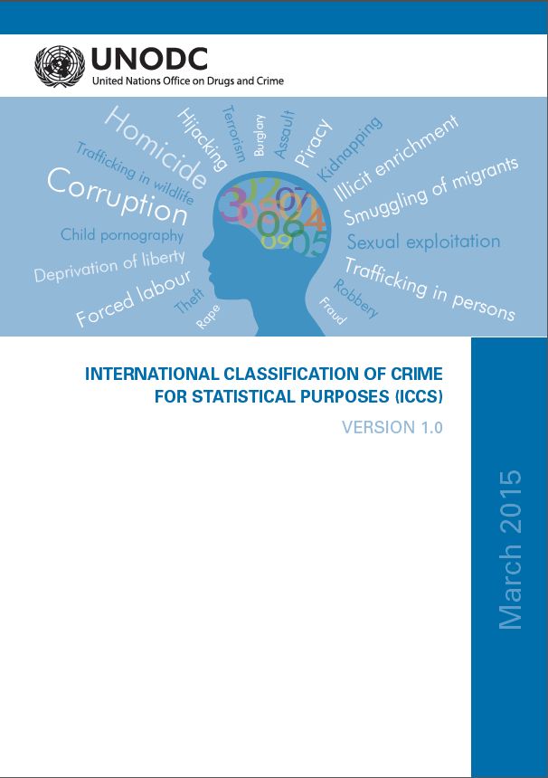
Improving Crime statistics to make it more relevant for SDG 16+ monitoring and policy making

Slide 7
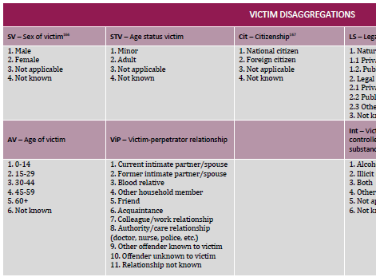
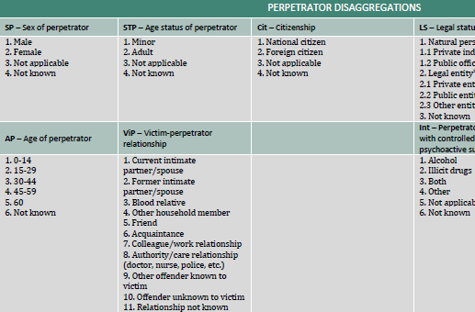
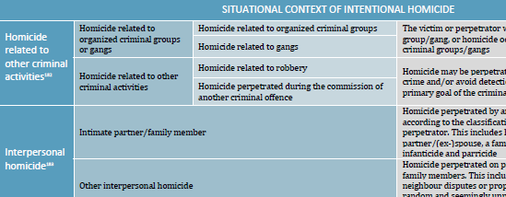
The power of disaggregations

Slide 8
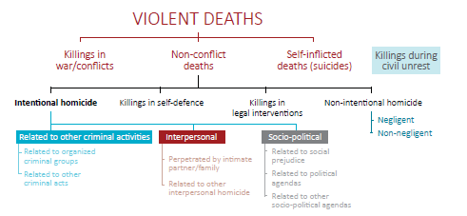
A zoom on homicide

Slide 9
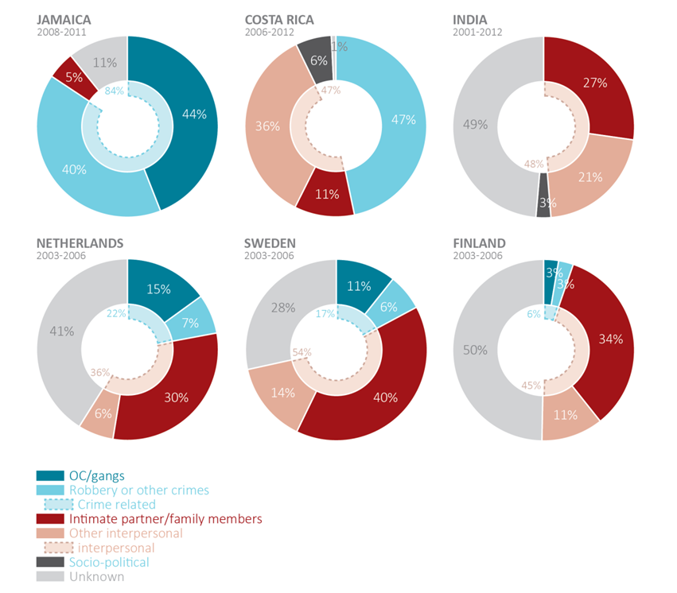
An example of the impact of the ICCS

Slide 10
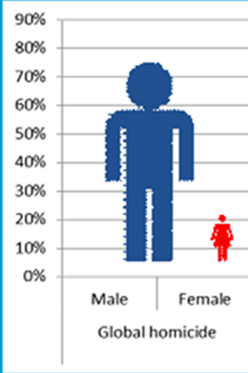
Gender-sensitive homicide statistics
Victims of homicide by sex, 2013-2014

Slide 11
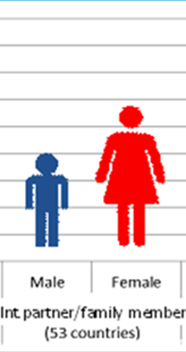
Gender-sensitive homicide statistics
Victims of homicide by sex and type, 2013-2014

Slide 12
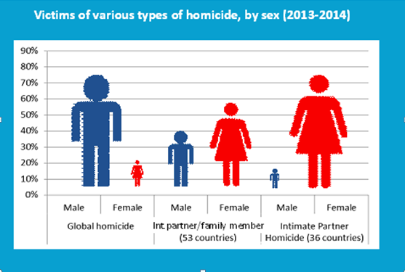
Gender-sensitive homicide statistics

Slide 13
Innovation
Revolution?

Slide 14
Progressive Revolution
Example of experience and perception

Slide 15
Innovation
New approaches
to estimates
Illicit Financial Flows model
Innovative use of existing sources
Use of hospital records
Framework to measure organized crime
Big data
National Firearms Data system
Multiple Systems Estimates (MSE)
Network scale approach in surveys
Use of surveys to estimate homicide

Slide 16
….Connecting the dots to measure transnational crime…
Need for regional and international cooperation on monitoring trafficking in persons, organized crime, illicit financial flows, firearms trafficking

Slide 17
National statistics can be improved with data from other countries and can help national authorities to address the problem
Wildlife seizures Source: UNODC WISE

Slide 18
Programme development, policy change
Advocacy
Data, statistics, indicators for what purposes?

Slide 19
SDG monitoring for policy change
Quality
Ownership
Coordination
In the spirit of goal 16 need to support transparent, effective, inclusive national statistical institutions

Slide 20
Thank you for your attention

