Slide 1
Project ‘Third National Communication of Albania to UNFCCC’
Training
Delivered during 17th – 21th March 2014
Hotel Mondial
by Devaraj de Condappa, Consultant

Slide 2
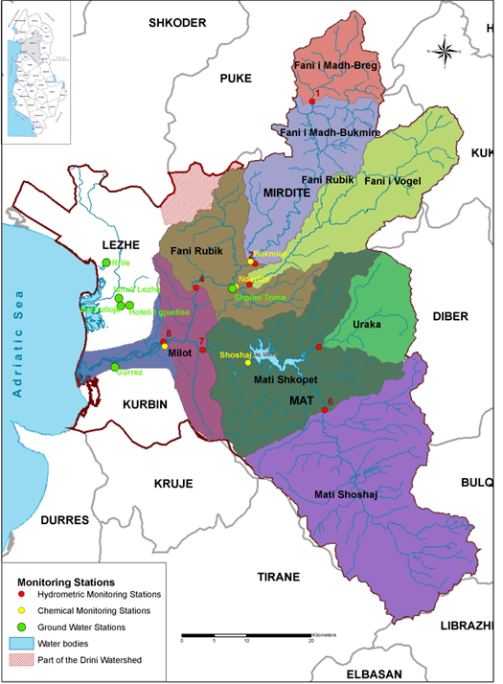
WEAP Training
ANC3
Scope - Improving the existing expertise in Albania on :
  water scenario development,
  water balance database and
  policy analysis on water development and management options with use of WEAP.
Attended by 20 participants:
policy and decision makers (employees of line Ministries),
engineers and projects’ managers,
researchers on hydrology and climate change adaptation policy and economists.

Slide 3
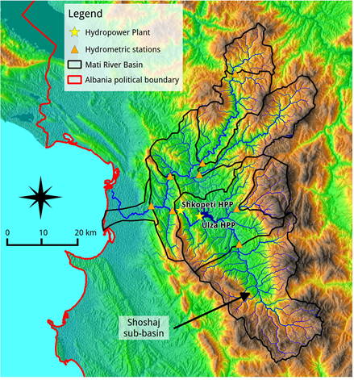
WEAP Training
ANC3
1.5 days of General Training, using the WEAP Tutorial developed by the Stockholm Environment Institute.
3.5 days of Specific Training on the Mati River Basin on:
  Hydrological and Reservoir Modelling
  Water Demand and Climate Change Scenarios
  link WEAP – LEAP

Slide 4
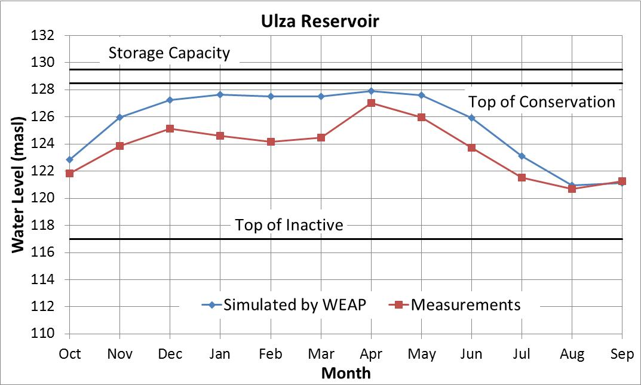
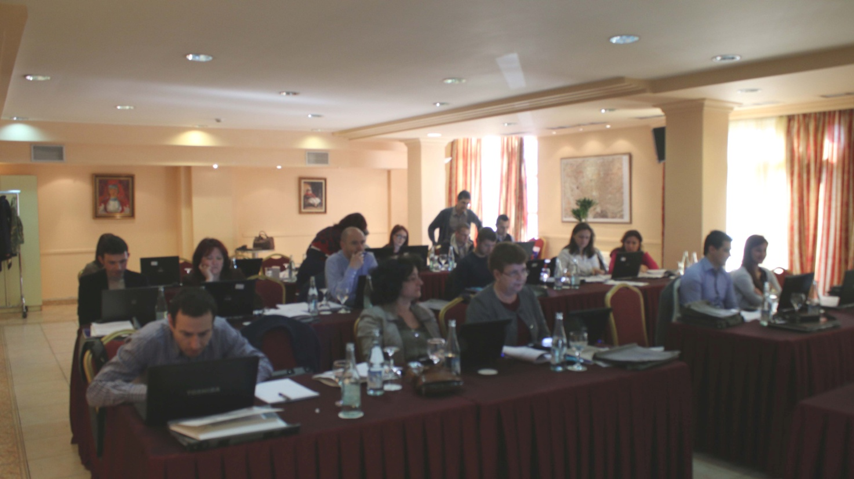
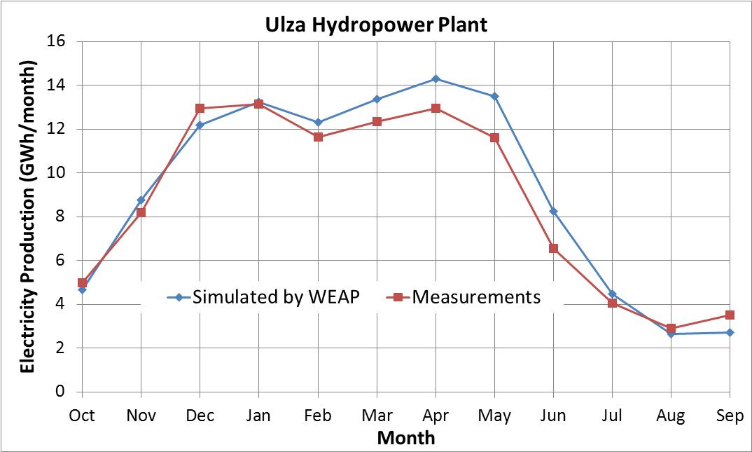
WEAP Training
ANC3
Modelling of the Ulza infrastructures

Slide 5
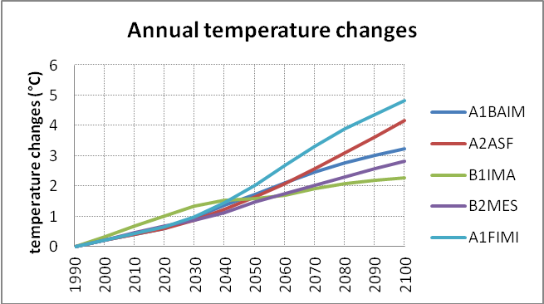
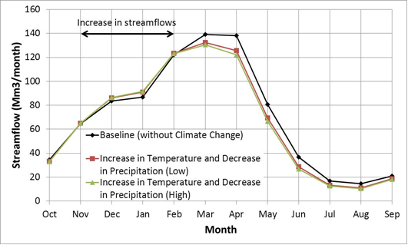
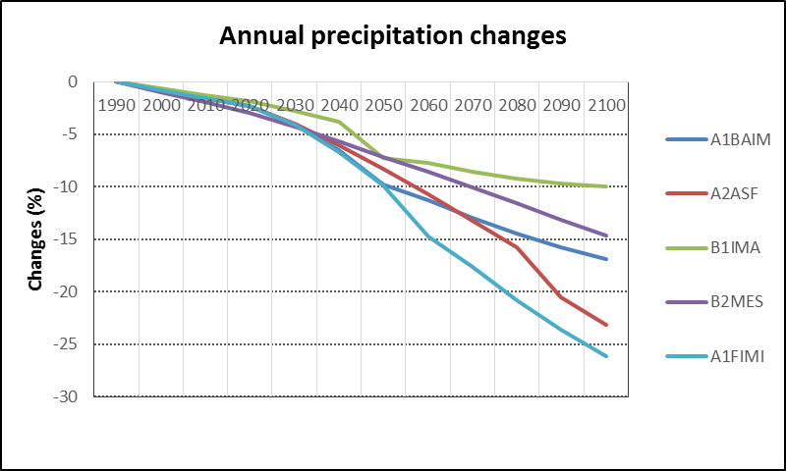
WEAP Training
ANC3
Temperature and precipitation scenarios of climate change for Albania.
CC impact on streamflows with WEAP, Scenario A2

Slide 6
