Slide 1
Project ‘Third National Communication of Albania to UNFCCC’
Preliminary Results

Slide 2
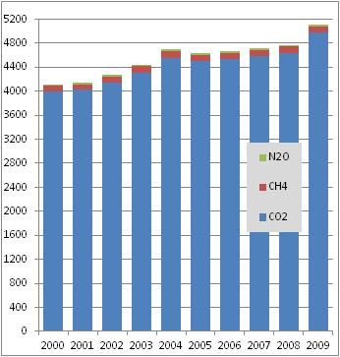
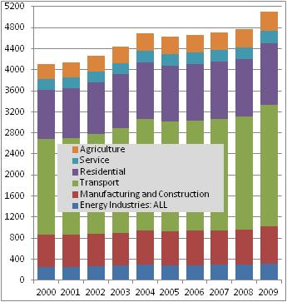
GHG Emissions from Energy and Transport Sector 2000 – 2009 [kt]

Slide 3
GHG Emissions from Agriculture Sector 2000 – 2009 [kt]

Slide 4
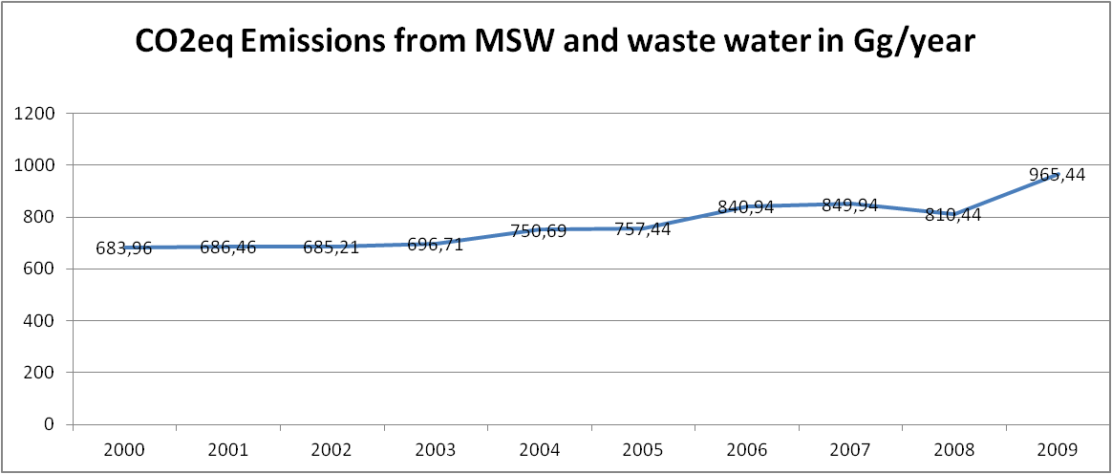
GHG Emissions from Waste Sector 2000 – 2009 [kt]

Slide 5
V&A activities under TNC
Focus: Albanian coastal area
Sectors/systems: water resources, agriculture, biodiversity, tourism and population, health, climate related disaster reduction
Tasks:
Develop the scenarios:
climate changes and sealevel rise; √
socio-economic √
Integrated assessment of (in process)
current climate vulnerability
climate change impacts and adaptation measures
Adaptation action plan based on ICZM up to 2050.

Slide 6
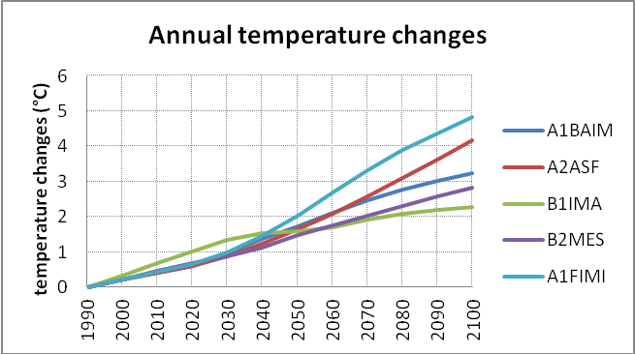
Expected changes (averages)
Temperature:
Annual likely up to 3.2°C(2.4-4-1°C) by 2100
Summer, extremely problematic, likely up to 5.3°C (4.6 -6.0°C) by 2100
Precipitation
Annual decrease likely to up to -18.1% (80.0 to -85.5%) by 2100
Sealevel -likely to increase up to 40cm, reaching the maximum level of 73 cm by 2100

Slide 7
Expected changes
Integrated climate change impact assessment – continues
Summer temperature

