Slide 1

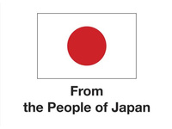



RESPONSIBLE BUSINESS PRACTICES AND HUMAN RIGHTS DUE DILIGENCE FOR BUSINESSES AND
THEIR SUPPLY CHAINS
Developed by UNDP Viet Nam in corporation with National Economics University
With the support of the Japanese Government
This document was developed based on the following two documents:
1. Human Rights Due Diligence Training Facilitation Guide at https://bit.ly/3tV9rVa
2. The Human Rights Self-Assessment (HRSA) Training Tool
at https://hrdd-assessment.org/

Slide 2
SECTION 3
HUMAN RIGHTS
DUE DILIGENCE

Slide 3
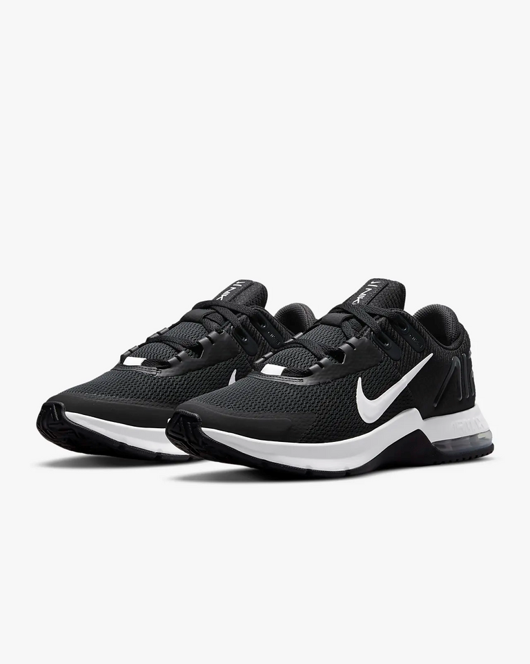

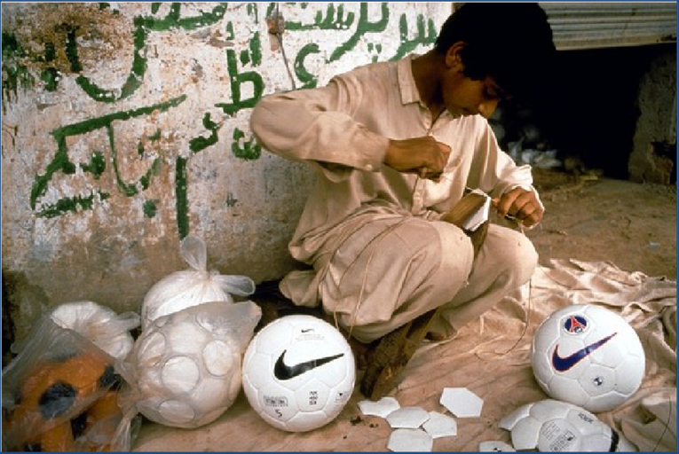
THE CHANGE OF NIKE
Responsible Business Practices in Viet Nam
RBP Viet Nam

Slide 4
Human Right Due Dilligence
Human rights due diligence requires companies to
assess impacts and risks in their value chain, and
act responsibly to prevent, mitigate and account
for human rights abuses in which they may be
involved through their own activities
and business relationships.
EFFORT
REASONABLE
EFFECTIVE
Responsible Business Practices in Viet Nam
RBP Viet Nam

Slide 5
BENEFIT OF HUMAN RIGHT DUE DILLIGENCE
  Establish early warming and allow for the prevention
  Secure the company's social license to operate
  Spend resources effectively where risk is high
  A better understanding of existing processes and governance
  Show investors and business partners that your company knows the risk and doing something meaningful about it
  Meet and exceed regulatory requirements and stakeholder expectations
Responsible Business Practices in Viet Nam
RBP Viet Nam

Slide 6
4 STEPS OF HUMAN RIGHT DUE DILLIGENCE
1. Identify and assess actual and potential human rights impacts
2. Integrate and act upon the findings
3. Track and verify effectiveness of responses
4. Communicate and account for how impacts are addressed and any results
Responsible Business Practices in Viet Nam
RBP Viet Nam

Slide 7

Part 3.1
IDENTIFY AND ASSESS ACTUAL AND POTENTIAL HUMAN RIGHTS IMPACTS

Slide 8


IDENTIFY AND ASSESS ACTUAL AND POTENTIAL HUMAN RIGHTS IMPACTS
What SPECIFIC impact will happen to SPECIFIC people in what SPECIFIC field of activity?
  The business must map its activities and business relationships
  The business must conduct consultations with potentially affected groups
Responsible Business Practices in Viet Nam
RBP Viet Nam

Slide 9

IDENTIFY AND ASSESS ACTUAL AND POTENTIAL HUMAN RIGHTS IMPACTS
Businesses need to identify and evaluate:
  Actual and potential negative risks and impacts on human rights
  Through its own activities or outcomes with stakeholders, including business relationships throughout the supply/value chain
This process should:
  Get information and expertise on human rights internally and from independent external sources (UNGP 18a)
  There should be genuine consultation with influential groups and other stakeholders and it should be appropriate to the company's regulations and the nature and context of its business. (UNGP 18b)
Responsible Business Practices in Viet Nam
RBP Viet Nam

Slide 10
IDENTIFY AND ASSESS ACTUAL AND POTENTIAL HUMAN RIGHTS IMPACTS
RISKS BY CATEGORY:
  Labor – fair wages, forced labor, child labor, occupational health and safety, and stigma and discrimination
  Environment and land – impact of toxics and pollutants, land rights and land use regulation
  Voice – freedom of association, collective bargaining and trade union membership
  Gender – sexual harassment, discrimination and violence against women
  Marketing and advertising – gender stereotyping, minority stereotyping, insensitivities towards groups that have suffered legacies of marginalization
  Product development and product use – surveillance technology, dual use products and safety
  Government relationships and security – corruption, intimidation and abuse by private security forces
  Indigenous Peoples – Free, Prior and Informed Consent; preserving culture and ways of life
  Digital rights and security – privacy rights, hate speech, intimidation and harassment, child protection
Responsible Business Practices in Viet Nam
RBP Viet Nam

Slide 11
IDENTIFY AND ASSESS ACTUAL AND POTENTIAL HUMAN RIGHTS IMPACTS
3.1.1 Identify stakeholders
3.1.2 Identify and assess potential for HR risks based on industrial and local environment value chain
3.1.3 Prioritize mitigation measures
Responsible Business Practices in Viet Nam
RBP Viet Nam

Slide 12

3.1.1 STAKEHOLDERS
A stakeholder is any party that has an interest in a company and can either affect or be affected by the business’s activities
Stakeholders should be facilitated to be meaningful engaged and consulted throughout HRDD, including identifying and assessing business’s impacts.
EMPLOYEES
OTHER GROUPS
SUPPLIER
GORVERNMENT
STALKE-HOLDER
EMPLOYEES IN THE SUPPLY CHAIN
COMMUNITY
CUSTOMER
SHAREHOLDER & INVERSTER
Responsible Business Practices in Viet Nam
RBP Viet Nam

Slide 13

3.1.2 ASSESSING INDUSTRIAL, LOCAL ENVIRONMENT AND VALUE CHAINS
Enterprises should:
  Identify the operating countries or regions of a country that have the greatest human rights risks.
  Identify human rights issues at risk in an industry or sector.
Identifying human rights risks and impacts requires enterprises to first conduct a broad review of known human rights issues before a more in-depth exploration.
Responsible Business Practices in Viet Nam
RBP Viet Nam

Slide 14
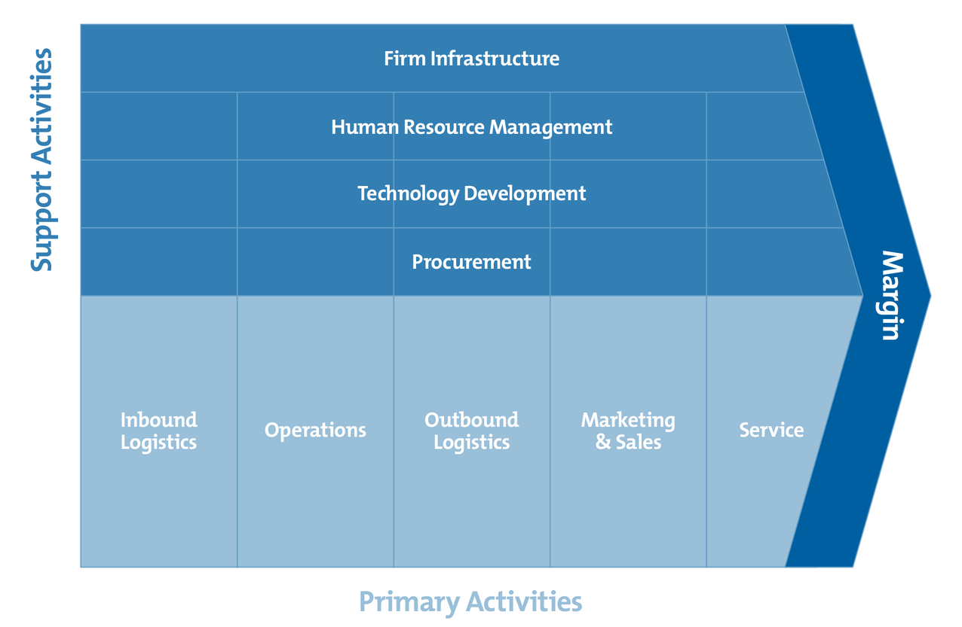
3.1.2 ASSESSING INDUSTRIAL AND LOCAL ENVIRONMENT
MICHAEL PORTER – VALUE CHAINS
Responsible Business Practices in Viet Nam
RBP Viet Nam

Slide 15

There are three ways a business can negatively impact human rights:
1
2
3
It causes violation
It contributes to violation
It links to violation
Responsible Business Practices in Viet Nam
RBP Viet Nam

Slide 16



1
A COMPANY CAUSES AN ADVERSE HUMAN RIGHTS IMPACT
A business activity is a cause when it is directly responsible on its own for the adverse impact
Enterprises conduct activities that pollute the environment
Discrimination occurs in the workplace
Exposure of factory workers to hazardous working conditions
Responsible Business Practices in Viet Nam
RBP Viet Nam

Slide 17


2
COMPANY CONTRIBUTES TO A HUMAN RIGHTS IMPACT
The enterprise contributes in one of two circumstances:
  When the business activity has a direct impact on someone’s human rights but alongside other entities
  When the business activity has an impact indirectly through other entities
Providing data about internet service users to a government that uses the data to trace and prosecute political dissidents
Changing product requirements for suppliers repeatedly and without adjusting production deadlines and prices, thus pushing suppliers to breach labor standards in order to deliver
Responsible Business Practices in Viet Nam
RBP Viet Nam

Slide 18


3
COMPANY IS LINKED TO A HUMAN RIGHTS IMPACT
A business may neither cause nor contribute to the impact but be involved because the impact is caused by an entity with which it has a business relationship and is linked to its operations, products, or services. In this circumstance, a company is linked to the adverse human rights impact.
Providing financial loans to an enterprise for business activities that, in breach of agreed standards, result in the eviction of a community
Embroidery on a retail company’s clothing products being subcontracted by the supplier to child laborers in homes, counter to contractual obligations
Responsible Business Practices in Viet Nam
RBP Viet Nam

Slide 19
Assessing actual and potential human rights impacts
1. Scope of assessment
2. Consideration
of business
context
3. Review
business
relationships
4. Utilization of
expertise
5. Consultation
of affected
stakeholders
On-going process: risks may change over time Cover the entire value chain of company (to see risks/impacts at all 3 levels (cause/contribute/linked) | Consider the context of risks Mindful of “internationally accepted human rights” | Relationship with government agencies Operations taken over/merged Joint ventures Contractors, consultants, agents, and suppliers Prioritize by potential severity of impacts | Internal expertise, such as labor unions, existing surveys, Environmental Impact Assessments (EIA) External expertise, such as government, local government, local NGOs, research reports etc. | Map relevant stakeholders Conduct appropriate and meaningful engagement for each stakeholder group
Responsible Business Practices in Viet Nam
RBP Viet Nam
Notes:
14

Slide 20
Examples of human rights impacts in Viet Nam
Child labour
Forced Labour
Discrimination
OHS issues
Fair remuneration and working hours
Four factors could result child-labour: Underage labour Prohibited works Dangerous, heavy and hazardous working conditions Excessive working hours Vietnam has around 1 million child labour Note: research more for the definition of child labour in the website of ILO | Working to which workers have not offered their voluntary. Examples include: Require all shift/team working overtime without getting consent of every individual; Hold documents/ salary of workers to force them coming back to work (after leaves or Tet holiday) Using “toilet card” or other measure to restrict workers’ movement | Discrimination upon the protected grounds (gender, ethnicity, language, social origin, birth, religion or other status). Examples includes: Recruitment with priority to male without justification Unequal payment between male and female who do the same work. Discrimination against workers coming from certain region. | OHS: Occupational Health and Safety. Safe and healthy working conditions are a fundamental right. Excessive hot atmosphere Working without protective equipment No or insufficient contingency plan and arrangement | The salary of Viet Nam is quite low. Many business are not paying “living wage” This forces workers to work in excessive overtime working hours and therefore risks their health as well as the enjoyment of other rights.
ILO, GSO and MOLISA (2018), Dieu tra quoc gia ve lao dong tre em, available at: https://www.ilo.org/wcmsp5/groups/public/---asia/---ro-bangkok/---ilo-hanoi/documents/publication/wcms_764355.pdf
Responsible Business Practices in Viet Nam
RBP Viet Nam
Notes:
14

Slide 21

3.1.3 PRIORITIZING
SEVERITY
PRIORITIZING
LIKELIHOOD
Responsible Business Practices in Viet Nam
RBP Viet Nam
Nguyễn Ngọc Hiên - hiennn@neu.edu.vn

Slide 22
3.1.3 PRIORITIZING
SEVERITY OF THE RISK
1
Scale: How grave or serious the impact would be
  2
  Scope: How widespread the impact would be
  3
Irremediability: How hard it would be to put right the resulting harm
Responsible Business Practices in Viet Nam
RBP Viet Nam
Notes:
Để đo mức độ nghiêm trọng yêu cầu giải nén ba mục sau các yếu tố:+ Quy mô: tương đương với trọng lực hoặc mức độ nghiêm trọng củava chạm+ Phạm vi: đề cập đến số người bị ảnh hưởng+ Khả năng không thể khắc phục: đề cập đến bất kỳ giới hạn nào trong khả năngkhôi phục những người bị ảnh hưởng trở lại tình trạng ít nhất làgiống như, hoặc tương đương với, tình huống của họ trướctác động bất lợi
16

Slide 23
3.1.3 PRIORITIZING
SEVERITY OF THE RISK
1
Scale
Nature and context of the abuse or treatment | Manner of the execution of the abuse | The status of the victim
Physical impact, for example, whether it involves loss of life or lifelong physical debilitation Mental or emotional impact, for example, if it leads to permanent mental illness or involves a temporary experience of humiliation The extent it affects family and community relationships | Duration of the abuse Duration of mental and physical anguish + Whether physical person and/or property is impacted Whether livelihood is destroyed or mitigated Whether persons are forcibly displaced and/or forced to take inadequate compensation + Whether it involved purposeful targeting or flagrant disregard for human dignit | Gender: man, woman, non-binary or transgender Age: adult or child State of health, including the mental health of the victim Disabilities status Sexual orientation: lesbian, gay, bisexual, or transsexual Minority or underclass status Whether vulnerability is compounded by a history of abuse suffered as a group
Responsible Business Practices in Viet Nam
RBP Viet Nam
Notes:
CÂU HỎI: MỨC ĐỘ NHƯ THẾ NÀO?
17

Slide 24

3.1.3 PRIORITIZING
SEVERITY OF THE RISK
1
Scale
HIGH
The abuse involves severe impact on the physical, mental and/or emotional well-being of a person and/or communities; the target community is considered especially vulnerable
MMEDIUM:
The abuse involves a moderate impact on the physical, mental and/or emotional well-being of people and/or communities
LOW:
The abuse does not have long-term or substantive effect on the victims’ lives and does not target vulnerable population
Responsible Business Practices in Viet Nam
RBP Viet Nam

Slide 25




3.1.3 PRIORITIZING
SEVERITY OF THE RISK
2
Scope
HIGH:
A large number of people affected, which might include the workforce, families or workers and surrounding communities
MEDIUM
A moderately large number of people impacted
LOW:
A small number of people impacted
Scope is a measure of the number of people involved. It often involves an estimation of the size of the group impacted. However, it may also include an estimate of the size of the community impacted as well.
Responsible Business Practices in Viet Nam
RBP Viet Nam

Slide 26



3.1.3 PRIORITIZING
SEVERITY OF THE RISK
3
Irremediability
High:
Unless action is taken immediately, the impact of human rights abuses can never be remedied
Medium:
Unless action is taken soon, the impact of human rights abuses will not likely be remedied
Low:
Action not required immediately to remedy the human rights abuse in full
Responsible Business Practices in Viet Nam
RBP Viet Nam

Slide 27

3.1.3 PRIORITIZING
LIKELIHOOD OF THE RISK
  Likelihood is the measure of the probability that the risk could lead to a harm.
  Measuring likelihood means looking at the company’s own operating contexts and the ability of the company’s various business relationships to effectively manage human rights risks.
  Likelihood is not considered a prevailing factor: it can only increase a severity rating, not decrease seve
HIGH
The event has occurred in the operation (or in the sector) several times per year, and will very likely occur again
MEDIUM
The event has occurred in the operation several times, and has occurred in the industry in the past
LOW
The event has never occurred in the operation, but it is possible that it has occurred in the industry in the past
Responsible Business Practices in Viet Nam
RBP Viet Nam

Slide 28
PRIORITIZING
MỨC ĐỘ NGUY HIỂM
High
MEDIUM | HIGH | CRITICAL
LOW | MEDIUM | HIGH
LOW | LOW | MEDIUM
Likelihood
Low
High
Low
Impact
Responsible Business Practices in Viet Nam
RBP Viet Nam

Slide 29
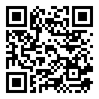
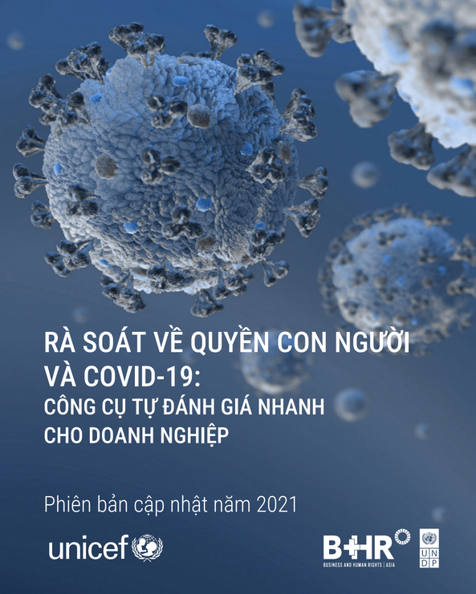
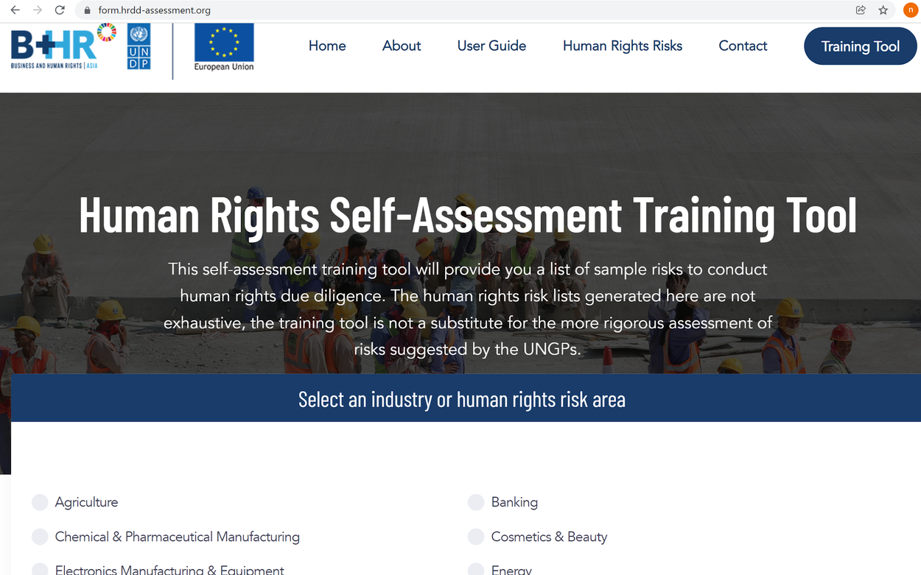
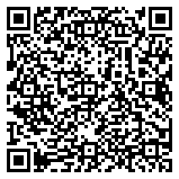
Human rights Self- Assessment Tool for reference
Link:
https://form.hrdd-assessment.org/
Link:
Human Rights Due Diligence and COVID-19: Rapid Self-Assessment for Business | United Nations Development Programme (undp.org)
Responsible Business Practices in Viet Nam
RBP Viet Nam

Slide 30


GROUP ACTIVITY 1
Analyze possible human rights risks of stakeholders along the value chain and prioritizing
Responsible Business Practices in Viet Nam
RBP Viet Nam

Slide 31
Part 3.2
INTEGRATING AND ACTING ON FINDINGS

Slide 32
3.2.1 The involvement of business in adverse human rights impacts and corresponding actions
3.2.2 Alternative actions
Responsible Business Practices in Viet Nam
RBP Viet Nam

Slide 33
3.2.1 THE INVOLVEMENT OF BUSINESS IN ADVERSE HUMAN RIGHTS IMPACTS AND CORRESPONDING ACTIONS
Action will vary depending on whether the business directly causes or contributes to these adverse impacts
1
2
3
It causes violation
It contributes to violation
It links to violation
Responsible Business Practices in Viet Nam
RBP Viet Nam

Slide 34
 | CAUSE | CONTRIBUTE | LINKED
Mode of Involvement
Response Fix Cease (post harm) Prevent (pre-harm) | The company itself should take steps to cease (post-harm) or prevent (pre harm) impacts | The company itself should take steps to cease (post harm) or prevent (pre-harm) impacts | Not applicable
Influence Leverage (post harm) | Not applicable | Influence others to tackle harm Build and use leverage to mitigate any remaining impact to the greatest level Including disengagement | Influence others to tackle harm Build and use leverage to mitigate any remaining impact to the greatest level
Provide remedy (post harm) | The company itself should provide remediation | The company should collaborate with others in remediation | The company should consider how to enable the remediation
  Company
  Company
One or more other actors
  Company
Company
  3rd party
  3rd party
  Affected stakeholder
  Affected stakeholder
  Affected stakeholder
  Affected stakeholder
Responsible Business Practices in Viet Nam
RBP Viet Nam

Slide 35

WHAT SHOULD HAPPEN WHEN AN IMPACT IS FOUND?
After detecting a possible harmful human rights impact, companies should take quick actions in line with the policies and procedures previously established.
This is what is meant by Remedy.
Detection of an adverse human rights incident may come from multiple sources:
  Company’s own routine internal monitoring according to procedures
  Internal or External stakeholder grievance or complaint filed with the company
  Third party notification, such as brand client, local authorities, etc.
  Others
Responsible Business Practices in Viet Nam
RBP Viet Nam

Slide 36
WHAT SHOULD HAPPEN WHEN AN IMPACT IS FOUND?
After carrying out the company’s procedures to remedy the adverse human rights impact, the company should conduct an internal review. This can take various forms.
  An after action review can be used immediately after incidents to analyze what happened, why the incident happened, and how it can be avoided in the future. These reviews help to put in place immediate changes to avoid new incidents.
  A root cause analysis is a process to more deeply assess the underlying causes of an incident, establish the timeline, identify the actors involved, distinguish between causal and correlation actions with a goal of better understanding the root causes that led to the incident. A benefit of this assessment is to uncover the incentives and disincentives of respecting human rights within the enterprise or its suppliers.
Responsible Business Practices in Viet Nam
RBP Viet Nam

Slide 37
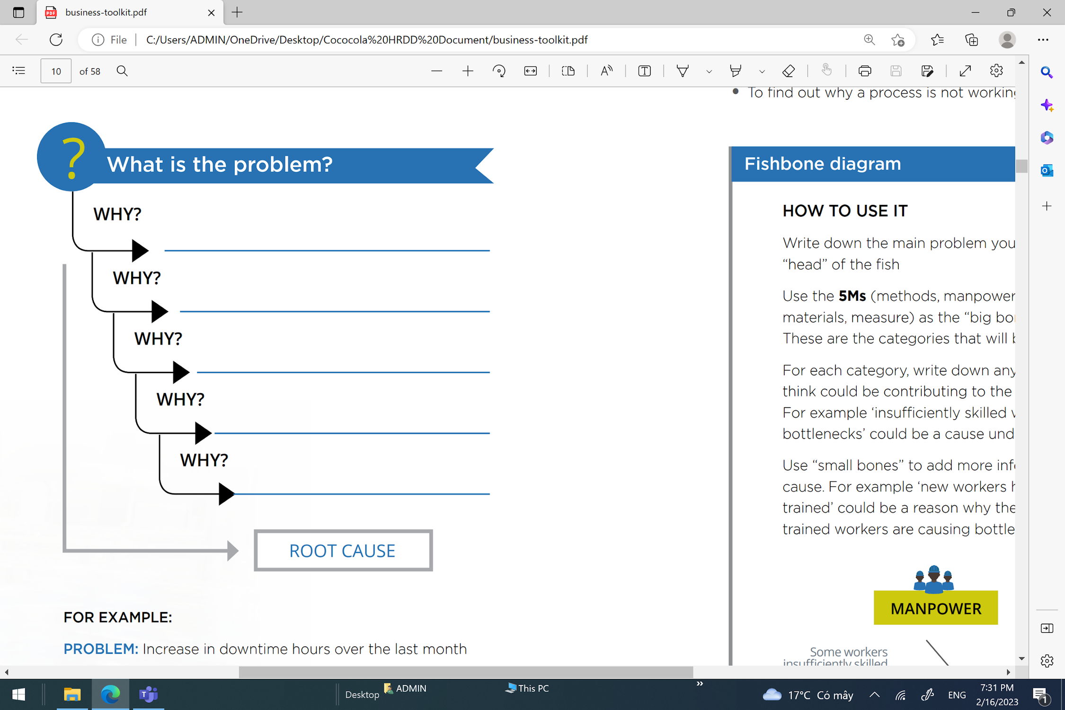
ROOT CAUSE ANALYSIS: THE 5 WHY
Responsible Business Practices in Viet Nam
RBP Viet Nam

Slide 38
DON’T SEEK ACCOUNTABILITY IN INDIVIDUALS
SEEK ACCOUNTABILITY IN THE SYSTEM
Responsible Business Practices in Viet Nam
RBP Viet Nam

Slide 39
EXAMPLES OF ROOT CAUSES
Lead time
Purchasing practices
Business model
Factory arrangement
Lack of training
Technology
Root causes needs to be addressed by preventive plan to mitigate human rights risks
Responsible Business Practices in Viet Nam
RBP Viet Nam

Slide 40

HAVE LEVERAGE
LACK
LEVERAGE
Mitigate the risk that the abuse continue/ recurs | Seek to increase leverage If successful seek to mitigate the risk that the abuse continue/ recurs If unsuccessful: consider ending relationship/ demonstrate efforts made to mitigate abuse, recognizing possible consequence of remaining
Try to mitigate the risk that the abuse continue/ recurs If unsuccessful take step to end therelationship | Assess reasonable options for increasing leverage to mitigate the risk that the abuse continue/ recurs If impossible or unsuccessful , consider ending relationship
Leverage – How much we have ?
CRUCIAL BUSINESS RELATIONSHIP
NON- CRUCIAL BUSINESS RELATIONSHIP
  Source: OHCHR, The Corporate Responsibility to Respect Human Rights, An Interpretive Guide. Available at https://www.ohchr.org/sites/default/files/Documents/publications/hr.puB.12.2_en.pd
Responsible Business Practices in Viet Nam
RBP Viet Nam
Notes:
Contract conditions is the core reason that we here to talk about this => Japanese brand require => main company something have dozen of supplier and in order to manage the key issue, they add condtion
Child labour
Health and safety
Brand and check, motitor

Slide 41
Leverage - Example
Form of leverage Example | Definition | Example
Traditional commercial leverage | Leverage that sits within the activities a company routinely undertakes in commercial relationships, such as contractual obligations or code of conduct (CoC) for suppliers. | The company includes a supplier’s sustainability (including human rights) performance in its broader supplier evaluation system, which informs how orders are placed. Better performance leads to longer relationships and higher volumes
Broader business leverage | Leverage that a company can exercise on its own but through activities that are not routine or typical in commercial relationships, such as capacity building | Through management support, feedback reports and follow-up visits, the company helps suppliers meet its standards and improve over time
Leverage together with business partners | Leverage created through collective action with other companies in or beyond the same industry | Energy utility companies participating in the initiative aim to increase their leverage with their coal suppliers by jointly pushing them towards improving standards and increasing transparency on mining-related human rights impacts
Leverage through bilateral engagement | Leverage generated through engaging bilaterally and separately with one or more other actors, such as government, business peers, an international organisation or a civil society organisation | By giving Oxfam access to its operations and suppliers in Vietnam and agreeing to a public report, Unilever benefited from the organisation’s expertise in addressing labour rights impacts in global supply chains
Leverage through multi-stakeholder collaboration | Leverage generated through action collectively with business peers, governments, international organisations and/or civil society organisations | Vietnam General Confederation of Labor and Inditex group has had dialogue activities. They built a network of grassroots trade unions of textile and apparel suppliers for Inditex in Vietnam, organizing training for trade union officials and facilitating dialogue between Inditex, employers, and trade unions
Responsible Business Practices in Viet Nam
RBP Viet Nam

Slide 42

How to evaluate human right risks of suppliers?
  Information from pre-qualification screening
  Information from self-assessment
  Information from assisting major suppliers in their HRIA
  On-site audits
Just having a supplier Code of Conduct (CoC) in place is not enough. Many suppliers cannot comply or do not see the importance. Therefore, companies should think about how to assess supplier capacity in following CoC, and how to help improve supplier capacity
Responsible Business Practices in Viet Nam
RBP Viet Nam

Slide 43

How to tell which supplier(s) might be high-risk?
Some possibilities
  Supplier/contractor operating in areas with clear evidence of human rights abuses or risks that rights are not being protected, e.g. lax enforcement of labor law
  Supplier/contract with history of human rights abuses or antagonistic behavior toward human rights defenders
  Supplier/contractor that delivers products or services that pose inherent risks (e.g. dangerous to health or safety)
  Supplier/contractor that are new or very small; may not be aware of human rights or lack the capacity to manage
Responsible Business Practices in Viet Nam
RBP Viet Nam

Slide 44

Do I have existing influence over this third party?
  Can I use this influence to mitigate the risk?
  Is this sufficient?
NO
YES
YES
Decision tree for using and building leverage
Can I increase my influence through my own actions?
NO
YES
  Can that influence mitigate the risk?
  Is this sufficient?
NO
YES
YES
  Can I increase my influence through another entity?
NO
NO
YES
  Can that influence mitigate the risk?
  Is this sufficient?
NO
YES
YES
  Can I increase my influence through collaborative action?
NO
NO
YES
NO
YES
  Can that influence mitigate the risk?
  Is this sufficient?
YES
  Can I replace this third party without additional harm to human rights?
NO
NO
YES
NO
YES
  Be able to explain the choice to continue with this third party
Souce: Shift, Oxfam and Global Compact Network Netherlands. Doing Business with Respect for Human Rights: A Guidance Tool for Companies (2016). Available at aim-progress.com/storage/resources/business-respect-human-rights-full.pdf
Responsible Business Practices in Viet Nam
RBP Viet Nam

Slide 45

3.2.2 What does integrating and acting upon findings require?
  Assigning responsibility for addressing risks and impacts to the appropriate unit within the business enterprise
  Ensuring efforts to address risks and impacts are: Supported by budget allocations, subject to oversight and compliance measures , aligned with internal decision-making processe
Responsible Business Practices in Viet Nam
RBP Viet Nam
Nguyễn Ngọc Hiên - hiennn@neu.edu.vn
Nguyen Ngoc Hien - hiennn@neu.edu.vn
Nguyễn Ngọc Hiên - hiennn@neu.edu.vn

Slide 46

What does integrating and acting upon findings require
  Integration may occur more naturally for small enterprises unencumbered by many departments, units or processes.
  Large enterprises will require a more systematized approach:
+ Collaboration between departments
– Example 1: human resources works with the legal department on matters related to contracts with recruitment agencies
– Example 2: the CSR/sustainability unit works with development teams involved in green-field investments
+ Developing clear reporting requirements, hosting regular interactions with external experts, and enhancing collective action with industry associations and government departments
+ Creating incentives for suppliers and other businesses to also respect human rights
Responsible Business Practices in Viet Nam
RBP Viet Nam

Slide 47
Integration and risk mitigation
2. Prioritization of risk/ impact for action
3. Determination of choices in prevention/ mitigation
4.
Utilization of leverage in business relationship
1.
Systematic integration and implementation
5.
Operation in high-risk context
Implement at operational level & firm- wide level Clear lines of responsibility: who will be responsible for each risk/impact | “Severity” of impact or potential impact to rights holder is most important Stakeholder engagement is key | Different methods to handle impacts based on level of company involvement Cause Contribute Linked | Leverage with state / local government Leverage with joint ventures Leverage with supplier / contractor / agent / consultant Leverage through other organizations | Preparation of crisis management plans Scope of “highrisk contexts” High social conflict Armed conflict

Slide 48
Part 3.3
TRACKING EFFECTIVENESS

Slide 49
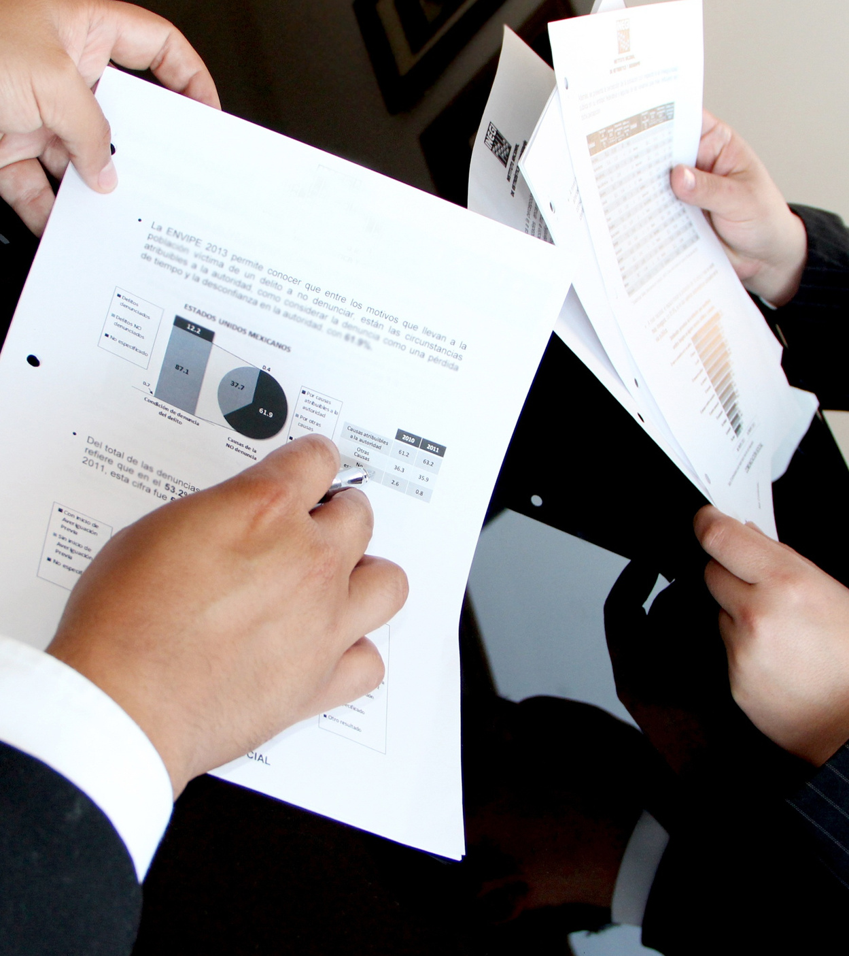
TRACKING
Tracking the effectiveness of efforts is essential if staff are to account for their success in respecting human rights and learn from any shortcomings. Tracking human rights issues and responses also helps a business to identify trends and patterns and delineate systemic challenges. Tracking may also allow for best practices to be identified and help improve business performance. Mostly, tracking is critical to preventing or mitigating the continuation or recurrence of human rights abuses.
Tracking requires:
+ Developing appropriate qualitative and quantitative indicators
+ Drawing from feedback from both internal and external sources
Responsible Business Practices in Viet Nam
RBP Viet Nam

Slide 50
IMPORTANT INDICATORS
Process/input indicators:
Incidents/impact indicators:
  Percentage of workers trained on human rights policy
  Percentage of workers who have access to operational grievance mechanisms
  Number of human rights impact assessments conducted
  Number of incidents of sexual harassment identified
  Number of instances where internet user data was passed to governments and on what basis + Number of employee injuries
  Number of instances of child labor reported
  Percentage of cases filed by employees, disaggregated by sex, with operational grievance mechanism
  Number of land rights violations reported to local government where supplier is operating
Responsible Business Practices in Viet Nam
RBP Viet Nam

Slide 51
TRACKING PLAN
1. See if the current process can provide sufficient information for tracking results
2. For big companies, it is important to consider the information used to track results at the headquarters level and at the branches and how to link this information.
3. Review relevant sources to see if the indicators are feasible/meaningful. See if there is a way to check these metrics inside and outside the company
4. Identify feedback and perspectives from stakeholders to help evaluate and interpret the metrics the company has
Responsible Business Practices in Viet Nam
RBP Viet Nam

Slide 52
Tracking, reporting and communications
1. Systematic tracking process
2. Development of indicator
3. Stakeholder involvement
4. Tracking through business
Relationship
Utilize company’s other tracking systems Need to track both operational level and corporate level Should analyze “root cause” of prevalent risks/impacts Design the tracking system that involves everyone in company Connect human rights performance to employee performance evaluation | Consider existing standards e.g. GRI Balance between quantitative & qualitative indicators Balance between outcome/impact indicators and process/input/acti vity indicators | Involve internal and external stakeholders, e.g. feedback on stand-alone HRIA, factfinding missions, or audits by independent third parties Focus on effectiveness of operational-level grievance mechanism | Role of contracts Information verification Meaningful monitoring and audits based on “partnership” between company and its business partners Exploration of new partnership opportunities
Responsible Business Practices in Viet Nam
RBP Viet Nam

Slide 53

GROUP ACTIVITIES
Group exercise 2
Determination of actions needed to prevent, and minimize human rights risks and make a tracking plan
Responsible Business Practices in Viet Nam
RBP Viet Nam
Notes:
13

Slide 54
Part 3.4
COMMUNICATING ACTIONS

Slide 55

What and Why?
COMMUNICATION
Communication requires business to report on their impacts as well as actions that are taken by business to prevent, mitigate and address their adverse impacts on human rights
Communication could increase stakeholder engagements and improve the transparency of business, reducing potential risks, helping business to meet reporting requirements/standards in global value chains
Responsible Business Practices in Viet Nam
RBP Viet Nam

Slide 56






FORMS OF COMMUNICATION
Internal communication
-Communicating within groups to know and tackle human rights impacts in different jurisdictions
-Communicating to establish consolidated group-reports
Regularly communicate to employees (through email, newsletters) about human rights issues
Incorporating human rights issues into annual reports
External communication
-Communicating with outside stakeholders upon their requests
-Communicating with business-partners in order to maintain the long-term business relationship
-Public and formal reports
Consultations with affected or potentially affected stakeholders
Direct or online dialogue
Formal report on human rights issues
Sharing information with trade unions and third parties
Responsible Business Practices in Viet Nam
RBP Viet Nam

Slide 57
Current legal landscape on human rights disclosure:
  EU non-financial reporting directive
  Anti-slavery laws in US, UK and Australia
  HRDD legislations with communication requirements (France, Netherland, Germany)
MEGA TREND: KNOWING AND SHOWING
Emerging reporting landscapes:
  EU sustainability due diligence directive (CSDD)
  Sustainability Financial Disclosure Regulation (SFDR)
  Corporate Sustainability Reporting Directive (CSRD)
  EU taxonomy regulation
  EU Sustainability Reporting Standards (ESRS)
  The International Sustainability Reporting Standard (ISRS)
Responsible Business Practices in Viet Nam
RBP Viet Nam

Slide 58
Stakeholder engagement
  Invest in a thorough identification of stakeholders and affected groups, and identify the best ways to engage them
  Relevant stakeholders should be consulted throughout the entire process: developing the policy commitment, HRDD, developing and operationalize remedial procedure
  Process should be inclusive, participatory (creating a sense of ownership), accessible, transparent, credible, culturallyappropriate, context-specific and gender sensitive
  Engage early, not only when a decision is imminent or a situation is escalating
  Establish clarity about process, goals and follow-up for all stakeholders involved and manage expectations proactively
  Seek feedback about their satisfaction with the process and the right to privacy
  Remain flexible, adapting to changing conditions and new stakeholders emerging
  Do not put stakeholders at risk through engagement
  Make sure the engagement process itself is rights-respective, e.g. respects Be aware of, and address power imbalances and other barriers to engagement (language, culture, gender etc.)
  Choose the right language for the right partner – not all are familiar with technical human rights or business language
Responsible Business Practices in Viet Nam
RBP Viet Nam

Slide 59
Groups with low power & interest should be prioritized
High
Joint venture partner
Vocal neighbor’s association
National trade union
Low
POWER/INFLUENCE
High
INTEREST
  Children living near building site
  Worker in the sand quarry supplying to the site
Migrant worker in in contracted workforce
  Source: Global Compact Network Germany and twentyfifty. Stakeholder Engagement in Human Rights Due Diligence (2014). Available at https://www.globalcompact.de/migrated_files/wAssets/docs/Menschenrechte/stakeholder_engagement_in_humanrights_due_diligence.pd
Low
Responsible Business Practices in Viet Nam
RBP Viet Nam

Slide 60

COMMUNICATION
Should be in a form and frequency that reflect an enterprise’s activities and commensurate with the human rights impacts. Should:
  Be accessible to intended audiences
  Provide information that is sufficient to evaluate the adequacy of an enterprise’s response to the particular human rights impact involved
  Not pose risks to affected stakeholders or personnel;
  Respect privacy (not include names/locations that could disclose identities of rightsholders who may face retaliation)
  Not pose risks to legitimate requirements of commercial confidentiality
Responsible Business Practices in Viet Nam
RBP Viet Nam
Notes:
54

Slide 61
GROUP ACTIVITIES
Group exercise 3
Dividing the class into three groups. Each group presents for 1 of 3 actors:
1. State
2. Enterprise
3. Affected community
Responsible Business Practices in Viet Nam
RBP Viet Nam

Slide 62
1. Inactive
2. Reactive
3. Advance
4. Proactive
STEPS UP HRDD AS A COMPANY
As little as possible | Comply with law and requirement | Understand risks and approach them proactively | Create positive impact for stakeholder
Responsible Business Practices in Viet Nam
RBP Viet Nam

Slide 63
1. Review
2. Sharing
3. Updating
4. Acting
STEPS FORWARD
Catalogue what policy your business have? Identify what policy your business don’t have? What is your procedure for each of adverse human rights issue? How procedure work in reality? What is the behaviour | Internal communication with your colleagues is very important. You can hold learning session or lunch to share the key takeaways of this training in your company Sharing your finished working sheet | Set “Responsible Business” and “business and human rights” in your google alert to keep updating yourself! Follow UNDP Vietnam fapage to update information | Suggest your idea for internal / external communication to your colleague or boss to enhance operation of your company
Responsible Business Practices in Viet Nam
RBP Viet Nam

Slide 64





AUTHORS
Ms. Nguyen Ngoc Hien
Email:
Hiennn@neu.edu.vn
Main Author
Mr. Nguyen Van Huan
Email:
nguyen.van.huan@undp.org
Mr. Le Quang Canh
Email:
canh@neu.edu.vn
Mr. Yuji Shinohara
Email:
Yuji.shinohara@undp.org
Ms. Do Nguyet Ha
Email:
do.nguyet.ha@undp.org
Design and layout the training document
Responsible Business Practices in Viet Nam
RBP Viet Nam
Nguyễn Ngọc Hiên - hiennn@neu.edu.vn

Slide 65


UNITED NATIONS DEVELOPMENT PROGRAMME
INSTITUTE FOR SUSTAINABLE DEVELOPMENT
Venue: 304 Kim Ma, Ba Dinh, Hanoi
Phone: (+84 4) 38 500100
Fax: (84-4) 37265520
Email: registry.vn@undp.org
Venue: Room 1503, A1 building, National Economics University, 207 Giai Phong, Hanoi.
Phone: (84) 24.36280280/6550; 6551
Email: isd@neu.edu.vn
Responsible Business Practices in Viet Nam
RBP Viet Nam

