Slide 1

Your Logo
Date//Time//Year
Pitch Deck
Telephone
Address
Website
+123-456-7890
123 Anywhere St.,
Any City, ST 12345
www.reallygreatsite.com

Slide 2

Your Logo
Date//Time//Year
About Our Company
Our History
In the presentation session, the background / introduction
can be filled with information that is arranged systematically
and effectively with respect to an interesting topic to be used
as material for discussion at the opening of the presentation
session. The introduction can provide a general overview for
those who are listening to your presentation so that the key
words on the topic of discussion are emphasized during this
background / introductory presentation session.

Slide 3

Your Logo
Date//Time//Year
Problems
A problem needs to be discussed further and in detail
because this problem is the main foundation in the initial
development of a product, service, and decision making.
Without a well-defined problem, it will have an impact on a
job that is unfocused, unmanaged, and less relevant.
The Society
The Environment
The Climate
Identify large problem
areas with the eagle view
approach so that this macro
stage is useful for knowing
the outcome of our work.
Don't forget to highlight
how we see a problem,
because our personal
method will be a plus point.
Identify as many of these
problems as possible but
still have a relationship to
each of these problems so
that the work will be more
focused on one topic.

Slide 4

Your Logo
Date//Time//Year
Solutions
Market
Industry
Uphold the spirit of
innovation and creativity
in shaping a solution
that can be accepted
by the wider community.
The solutions offered
need to be based on
sound market decisions
so that they can have
an impact.
SEM
End User
Give an explanation that
the solutions offered are
based on data and analysis
that are very precise and
focus on the problem.
The solutions offered need
to be based on sound market decisions so that they can
have impact.
Show that we offer a solution that solves the
problems previously described and identified.
Make sure that the solutions we offer uphold
the values ​​of effectiveness, efficiency, and are
highly relevant to the market situation and society.

Slide 5
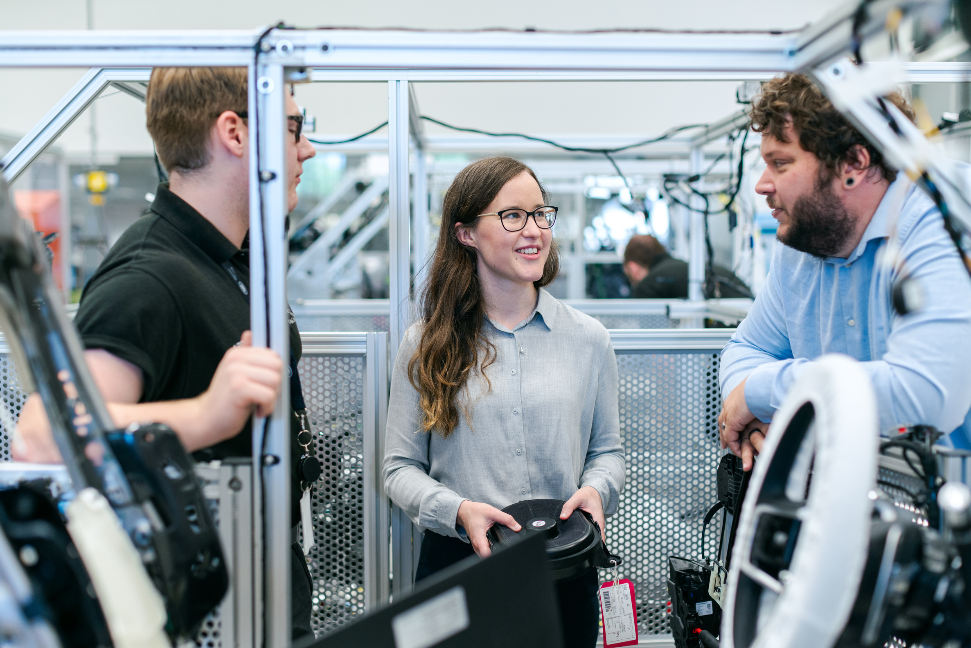

Your Logo
Date//Time//Year
Product
Overview
Internet of Things Tools
Describe one by one the products
we have in detail and effectively.
The more products / services
we have, it can show the level of
our exploration towards solving
community and market problems.
Smart Home Platform
Provide an explanation of the general
profile of the services we have. Arrange
information about our products services
in a systematic and fact-based manner.
Also express our pride in the service that
we have done well.
The product category that
we serve as an alternative is
offered. However, what we
offer must relate to one
another in solving society
and market problems.

Slide 6

Your Logo
Date//Time//Year
Market Size
Total Available Market (TAM)
$ 1.4 Billion
In the TAM Section, we can fill in the
potential of any person who can buy an
offer or the maximum amount of revenue
a business can earn by selling their offer.
Serviceable Available Market (SAM)
$ 194 Million
It is a part of TAM that has the potential to
become a target market for the company by
considering the type of product, technology
available and geographical conditions.
Serviceable Obtainable Market (SOM)
Market size is the total amount of all sales and customers that can be seen directly
by stakeholders. This technique is usually calculated at the end of the year, the
market size can be used by companies to determine the potential of their market
and business in the future. This is very useful, especially for new companies that will
offer services to those who are interested in our services.
$ 167 Million
The SOM is a smaller fraction of the SAM that
is the target of a serviceable and realistically
achievable market in the short to medium term.

Slide 7

Your Logo
Date//Time//Year
Market Validation
It’s a market testing stage to ensure that the products
produced by the company can be accepted and
effectively used by the broad market. For start-up
companies, we can use data already achieved by
similar products from other companies.
Really Great Site
Really Great Site
Really Great Site
2.650K
1.850K
1.010K
Total Users
Total Users
Total Users

Slide 8
Your Logo
Date//Time//Year
Company Traction
Traction is a period where the company is feeling
momentum during its development period. If traction
momentum is not harnessed, sales figures can decline
and the customer base can shrink. In general, companies
will judge success by the amount of revenue and new
customers they receive.
50
Artificial Intelligence
We can explain in detail the
momentum of the company
and the basic facts that are
taken to show that our
company is in a traction phase.
40
+45%
30
We can explain in detail the
momentum of the company
and the basic facts that are
taken to show that our
company is in a traction phase.
Internet of Things
+53%
20
10
We can explain in detail the
momentum of the company
and the basic facts that are
taken to show that our
company is in a traction phase.
Others Products
+42%
0
2021
2022
2023
2024
2025

Slide 9
Your Logo
Date//Time//Year
Product Performance
Revenue
Development
3,46 M/Quarter
Quarter 1
Quarter 2
Engagement
Development
87%-91%/Quarter
Quarter 3
87%-91%/Quarter
Exposure
Development
Quarter 4
Total Clients
by Quarter
112 - 167 Clients
0
10
20
30
40

Slide 10

Your Logo
Date//Time//Year
Business Model
The Brief Percentage of LTV
The Ratio:
60:40
The Brief Percentage of CAC
80
Describe how to monetize, who your customers are,
distribution channels or fee structure. The goal is to get an
idea of how this business will survive your product or service
and tell how your company will make money and achieve its
goals. This can be indicated by graphs, statistics, or charts.
Use the Life Time Value (LTV) and Customer Acquisition
Cost (CAC) metrics to provide a clearer picture.
60
40
20
0
Internet of Things
Artificial Intelligence

Slide 11

Your Logo
Date//Time//Year
Competitive Advantage
Niche
We may offer products
or services that are
more unique or new
to the market than
our competitors.
Easy
Relationships are a gift
because they greatly
influence the exposure
of our products and
services.
Agile
Offers a market
advantage that is more
focused according to
market needs than a
more general market.

Slide 12




Your Logo
Date//Time//Year
Our Super Team
Fill in the experience, assignments, and how
good your company team are. Include the
hobbies of the personnel to break the ice.
CEO
CFO
COO
CTO
Anna Robertson
Fay Edwards
Robbie Gaspard
Timo Lavilla

Slide 13
Your Logo
Date//Time//Year
Thank You
Write down your hopes for the future of
your company. Don't forget to thank the
company for the opportunity and convince
related parties to support your company.
Address
123 Anywhere St., Any City, ST 12345
Telephone
Website
Because, we're here to help
+123-456-7890
www.reallygreatsite.com

