Slide 1
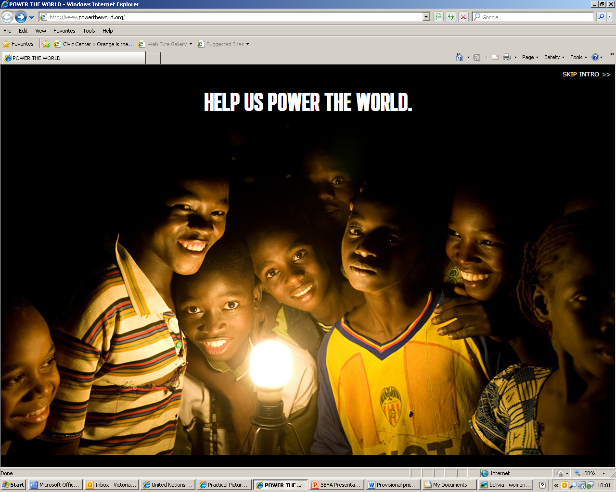
Sustainable Energy for All
Energy is opportunity. It transforms lives. Economies. And our planet.
© The Energy Resource Institute
www.sustainableenergyforall.org

Slide 2
Power to the people
“With this energy I have more time. It has made things so much simpler. Life is good”
“The power is wonderful. All of us will feel the benefit for many years to come”
“When my neighbours saw that I had more time for other things, they decided to install their own biogas plant too!”
“We didn’t know wind could generate electricity – it was hard to believe”
“Because I’m not burning as much firewood, cooking has become cleaner and safer”
www.sustainableenergyforall.org

Slide 3
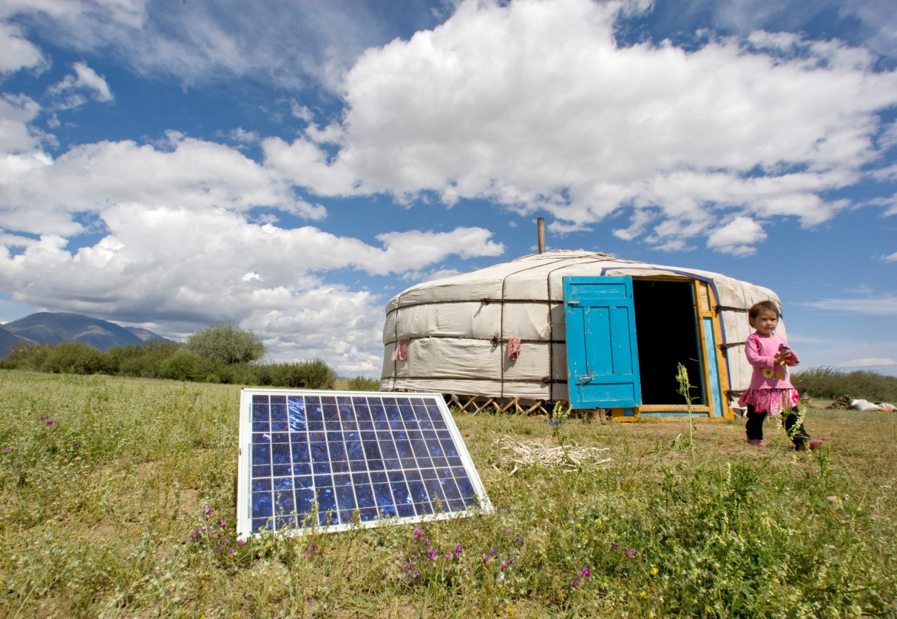
Providing Sustainable Energy for All
‘Energy is the golden thread that connects economic growth, increased social equity, and an environment that allows the world to thrive’
Ban Ki-moon, United Nations Secretary-General
Today the world faces two urgent and interconnected challenges related to modern energy services – based on where they are available and where they are not.
The key to both challenges is to provide sustainable energy for all – energy that is accessible, cleaner and more efficient.
© UNDP
www.sustainableenergyforall.org

Slide 4
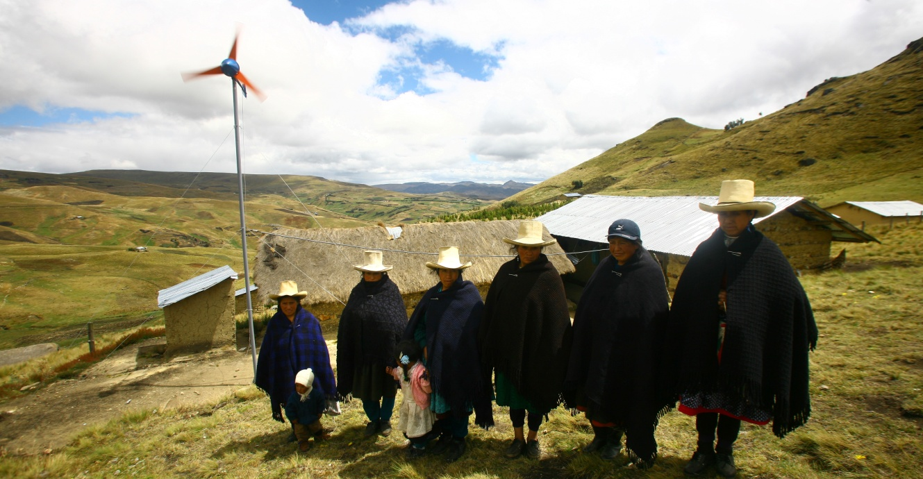
Three underpinning objectives
The United Nations Secretary-General has launched a pioneering initiative, ‘Sustainable Energy for All’, to mobilise urgent global action.
The initiative has three underpinning objectives:
Ensuring universal energy access to modern energy services
Doubling the rate of improvement in energy efficiency
Doubling the share of renewable energy in the global energy mix.
© Practical Action
www.sustainableenergyforall.org

Slide 5
Energy as a driver for development
Why energy access is fundamental…
Without access to energy, billions of women, men and children are denied the opportunity to improve their lives - to cook food, to heat the home, to earn a living, to benefit from good health and education services.
With access to energy, whole communities have the power to challenge their poverty, helping to realise the Millennium Development Goals in the process.
In 2000, when world leaders committed to the eight Millennium Development Goals to achieve by 2015, energy did not feature.
Now, with just three years remaining until those Goals need to be reached, energy access is fully recognised as crucial to human development - on a personal, national and global scale.
www.sustainableenergyforall.org

Slide 6
Energy access is fundamental to the Millennium Development Goals
Extreme poverty and hunger
Modern fuels reduce time spent collecting fuel (such as firewood) and increase time for income-generating activities.
Improved lighting reduces expenditure and boosts productivity.
Refrigeration reduces food and crop waste.
Universal primary education
Lighting allows children to study at night.
Energy access can help rural schools to attract teachers.
Improved cooking facilities free-up time spent collecting wood, for education.
Electricity allows use of Information Technologies in education, and access to Internet.
Child mortality
Reduction of smoke inhalation and household heating can improve child health and save lives.
Health services are improved through lighting, heating and refrigeration.
Improved lighting reduces deaths and injury from burns and fires.
www.sustainableenergyforall.org

Slide 7
Scale of the issue
One person in five on the planet still lacks access to modern electricity.
Twice that number, almost three billion people, rely on wood, coal, charcoal or animal waste for cooking and heating
© International Energy Agency
www.sustainableenergyforall.org

Slide 8
The Bigger Picture
‘Business as usual’ projections predict that the billions of women, men and children denied the opportunity to improve their lives will be the same in 20 years’ time.
By 2030:
900 million people will not have access to electricity
3 billion people will still cook with traditional fuels
More than 30 million people will have died due to smoke-related diseases
Many hundreds of millions will be confined to poverty due to lack of energy access
‘Business as usual’ is no longer an option. We need to move towards achieving sustainable energy for all.
www.sustainableenergyforall.org

Slide 9
Achieving Sustainable Energy for All
Affordable and reliable modern energy for all by 2030 is achievable.
To achieve it, together we must:
Adopt a clear statement that modern energy access is a political priority
Mobilise additional public and private investment in universal access
Encourage national governments to adopt strong governance and regulatory frameworks and invest in internal capacity building
www.sustainableenergyforall.org

Slide 10
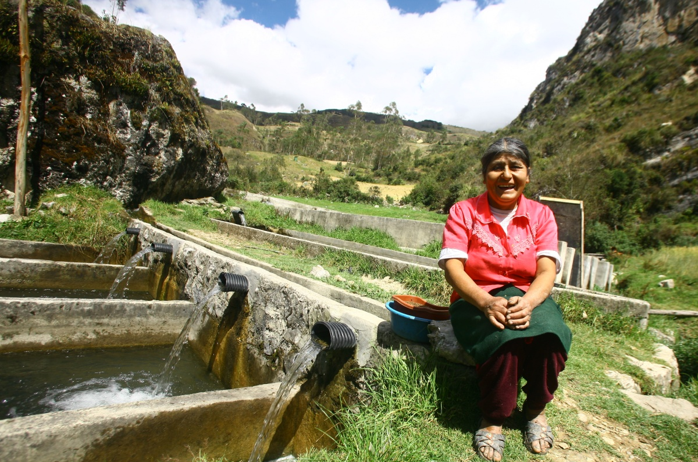
Challenges we will face
Achieving sustainable energy for all by 2030 will not be without challenges;
Path Dependence
Financial Obstacles
Pricing and regulatory policies and practices
Business models
© Practical Action
www.sustainableenergyforall.org

Slide 11
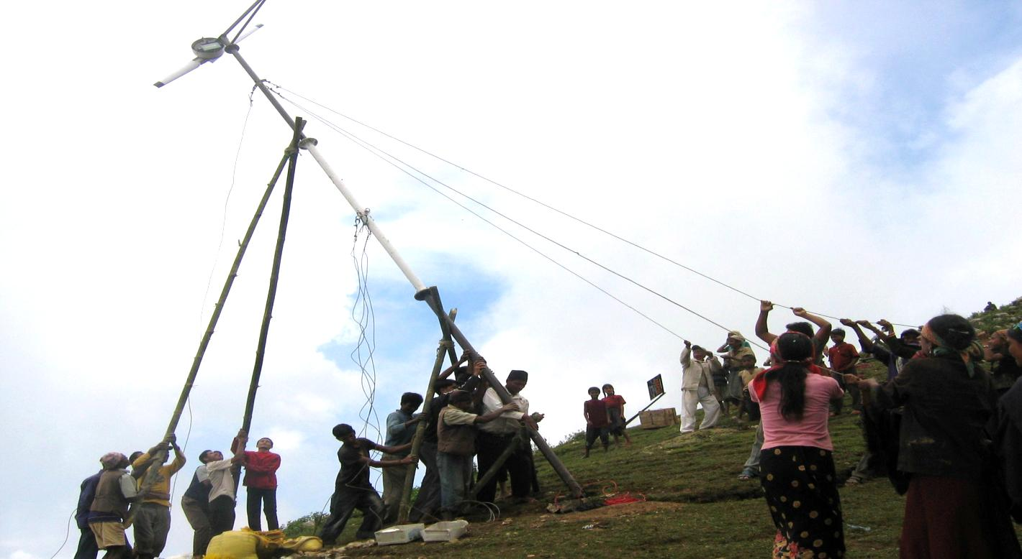
Working together to overcome the challenges
‘I urge the leaders of governments, civil society, communities, and the private sector to turn this vision into reality with concrete commitments to action. With right actions, world leaders can improve the lives of billions of people.’
Ban Ki-moon, United Nations Secretary-General
© Practical Action
www.sustainableenergyforall.org

Slide 12
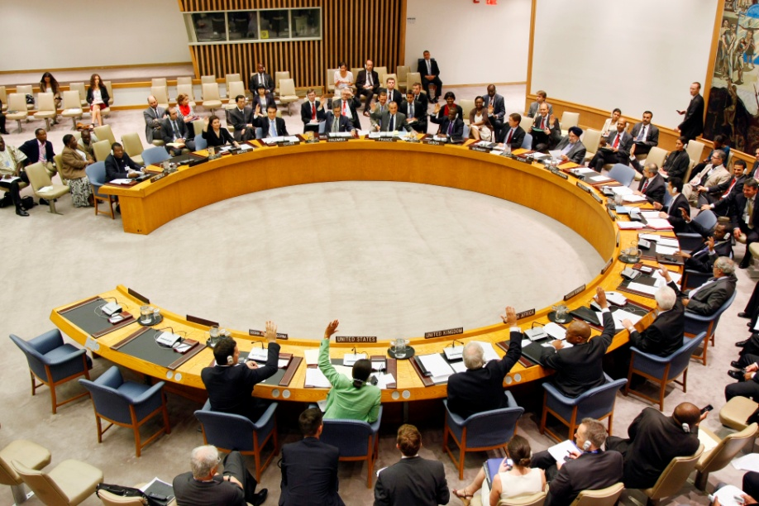
Commitments that create the Sustainable Energy Future we want
What is a Commitment to Action?
Commitments can take many forms, but should be measurable and should help move the world toward achieving sustainable energy for all 2030.
Who needs to commit?
Governments
Private Sector
Civil Society
UN Photo
www.sustainableenergyforall.org

Slide 13
Governments
ACTION:
Governments and international institutions can develop national energy plans and targets, provide financial support, and remove unproductive tariffs and subsidies.
MESSAGES:
Access: Delivering sustainable energy access will strengthen social and economic development.
Efficiency: In a time of economic difficulty, energy efficiency makes financial sense.
Renewables: The cost of climate change is greater than the cost of providing renewable energy. By championing renewable options, countries can build more resilient, competitive economies.
www.sustainableenergyforall.org

Slide 14
Examples of actions to drive change
Access:
Efficiency:
Renewables:
Strengthening energy policies and/or institutions and integrate energy access into broader government strategies.
Adopting government policies to reduce impediments to energy-efficient practices.
Adopting government policies to promote investment, manage risk, and reduce impediments to adopting renewable energy.
www.sustainableenergyforall.org

Slide 15
Private Sector
ACTION:
Companies can make their operations and supply chains more energy efficient and form public-private partnerships to expand sustainable energy products and services.
MESSAGES:
Access: Delivering sustainable energy provides new opportunities for entrepreneurship and growth during the economic downturn.
Efficiency: Increase your competitive advantage by becoming more energy efficient.
Renewables: Green growth provides a real market opportunity – capitalise on global demand for renewable energy.
www.sustainableenergyforall.org

Slide 16
Examples of actions to drive change
Access:
Efficiency:
Renewables:
Forging innovative public-private partnerships and developing new business models.
Developing new financing partnerships to de-risk private investment in developing countries.
Creating business incentives for innovation in energy efficiency and renewable energy.
www.sustainableenergyforall.org

Slide 17
Civil Society
ACTION:
Civil society groups can train people, conduct advocacy, offer technical expertise and encourage transparency.
MESSAGES:
Access: Development is not possible without energy access. Sustainable development is not possible without sustainable energy access.
Efficiency: The future of people and planet depends on a step-change in our energy usage.
Renewables: Increasing the share of energy from renewables is common sense. It will improve quality of life for all citizens, create local jobs and improve energy security while protecting the environment.
www.sustainableenergyforall.org

Slide 18
Examples of actions to drive change
Access:
Efficiency:
Renewables:
Scaling up existing renewable projects.
Installing a broad range of technical solutions and energy sources.
Creating new low-cost and reliable technology solutions.
www.sustainableenergyforall.org

Slide 19
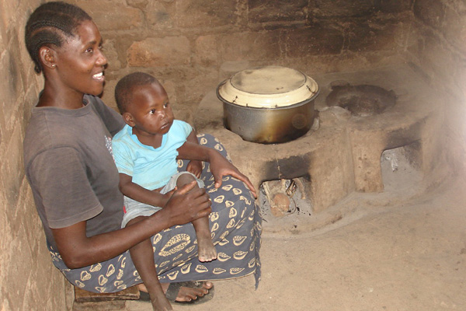
Energy transforms lives
Making life easier for rural women in Tanzania
Until January of this year, Stella Fungameza – a 30-year-old mother from Tanzania - wandered into the forest twice a week for 12 hours, bringing home up to 30 kilograms of firewood from each of her trips.
Now Stella can cook with half the amount of firewood, thanks to an energy project piloted by the United Nations Development Programme (UNDP).
UNDP is working with the government to provide more efficient cooking stoves so that people will not have to collect and burn so much firewood.
The new stoves emit less smoke indoors – improving overall public health – and, in addition, women like Stella can spend more time with their children or launch a second income stream.
“I now collect firewood only once a week…I can sit in the kitchen with my children because the new stoves give out very little smoke”
© UNDP
www.sustainableenergyforall.org

Slide 20
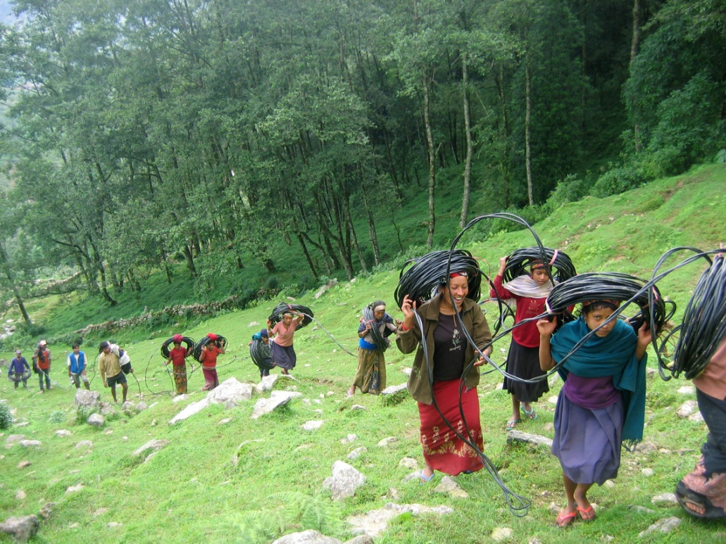
Energy transforms lives
Renewable energy lighting up a village in Nepal
In rural Nepal, where 73% of the population still does not have access to basic energy services, Practical Action has established “Renewable Energy Villages" demonstrating how renewable energies - micro hydro, solar and wind, can make an enormous difference to people’s lives.
The provision of energy is critical to help people escape poverty.
Practical Action's Renewable Energy Village in a Chepang Village in Gorhka district has meant that 13 villages now have access to lighting from renewable energy sources. These sources include wind/solar hybrid, micro-hydro, pico-hydro and solar lamps.
For Kul Bahadur Chepang, having solar powered lamps has transformed his family's life;
“…these lights are not only improving my children's study habits, they are also helping me to save money that I used to spend on kerosene. Practical Action has helped to show us the way towards light”
© Practical Action
www.sustainableenergyforall.org

Slide 21
Building the future we want through Sustainable Energy
Sustainable energy for all is an idea whose time has come.
Turning ideas into action depends on us all.
There is no time like the present to power a brighter future.
© Practical Action
www.sustainableenergyforall.org

